Slide 1
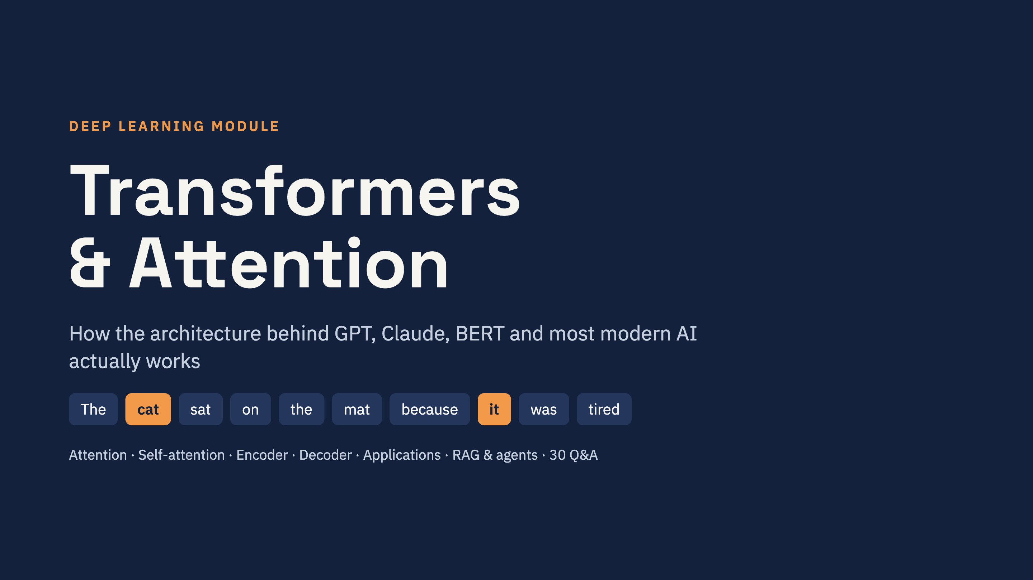
Notes:
Open with the running example: how does a model know that "it" means the cat? That one question is what this whole module answers. Everything today, from attention to RAG, comes back to this sentence.

Slide 2

Notes:
Order matters: we go from the problem (why), to the overall picture, then follow the data through the model: tokens, positions, attention, the block, and finally how the model is trained and used in RAG and agents.

Slide 3
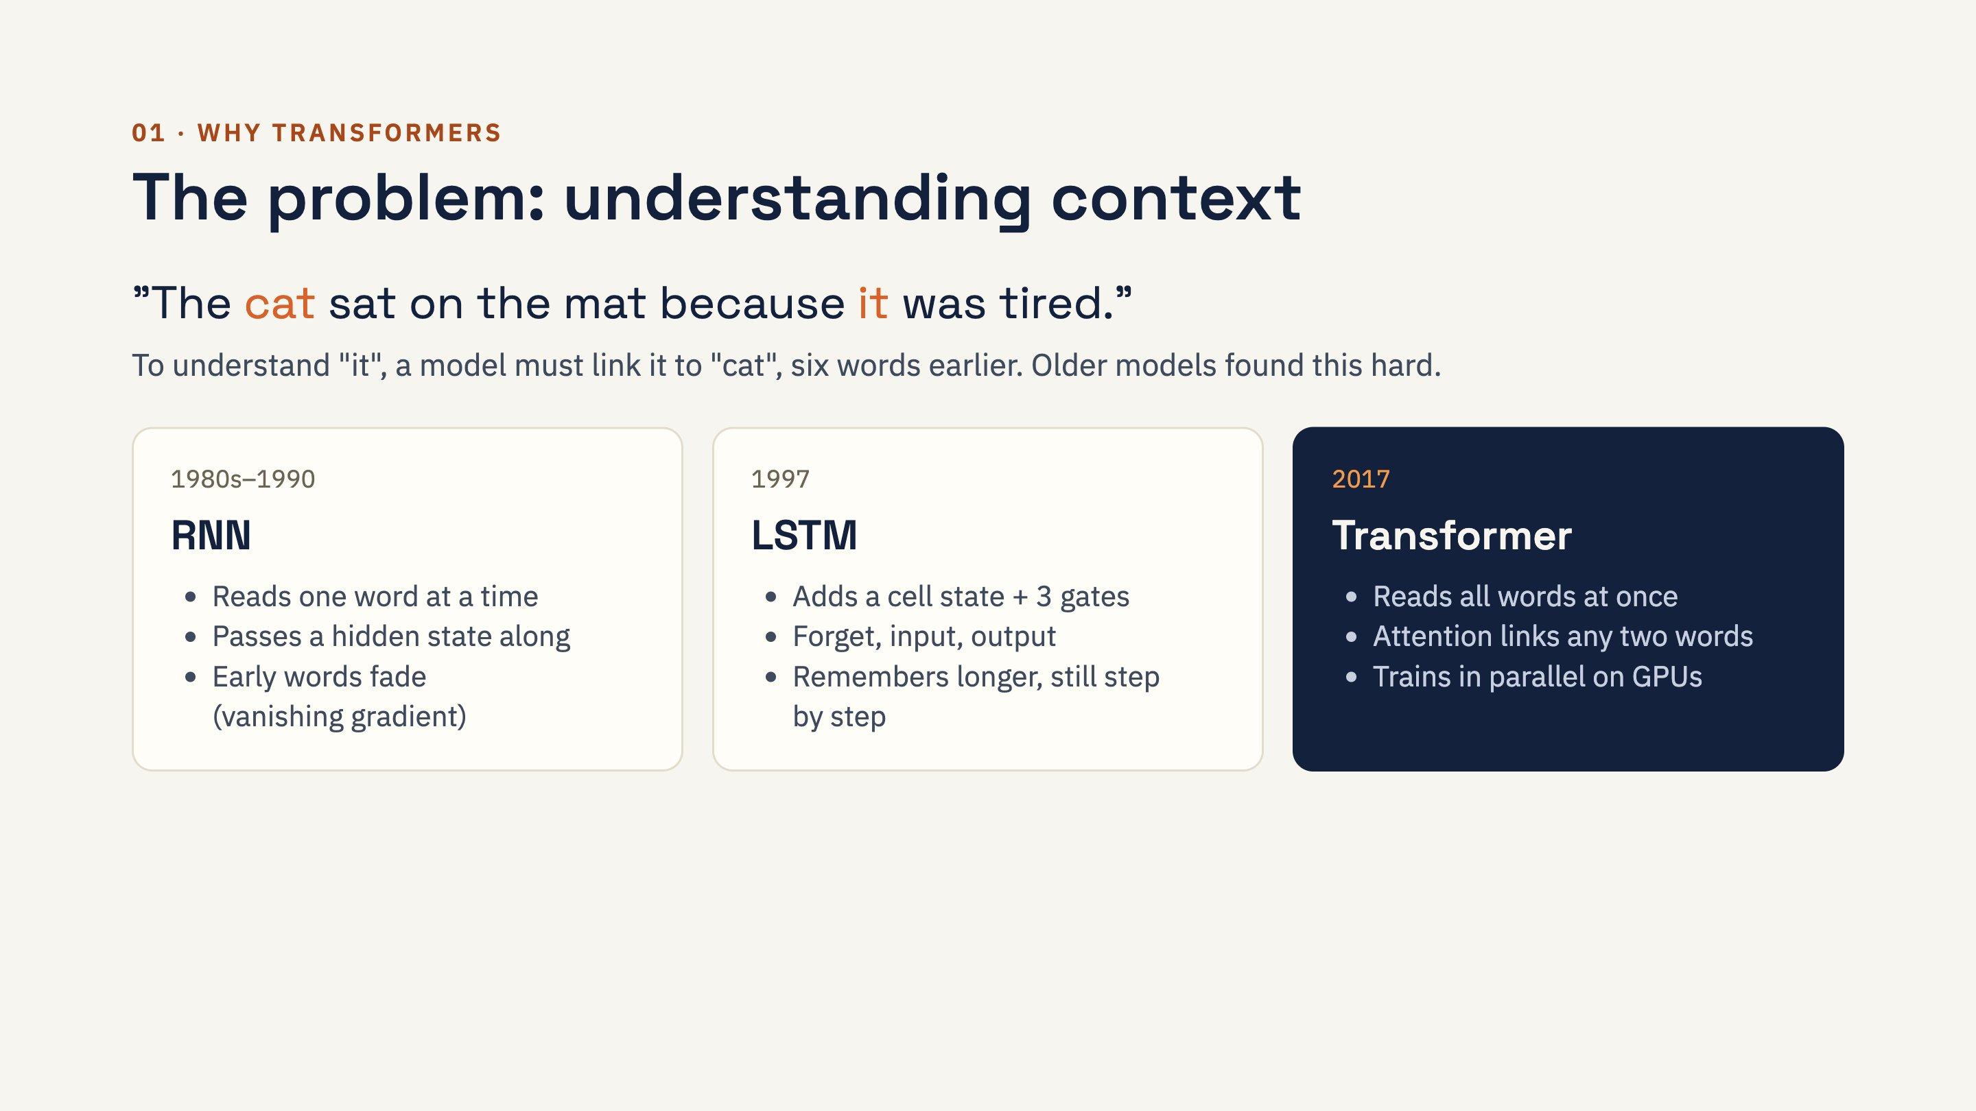
Notes:
RNN: like reading with a short memory and no notes. LSTM: reading page by page with a notebook, deciding what to write and erase (forget, input, output gates). Transformer: seeing the whole page at once and drawing lines between related words. Each model fixed the previous one's problem: RNN forgets, LSTM adds gates, Transformer removes the step-by-step bottleneck.

Slide 4
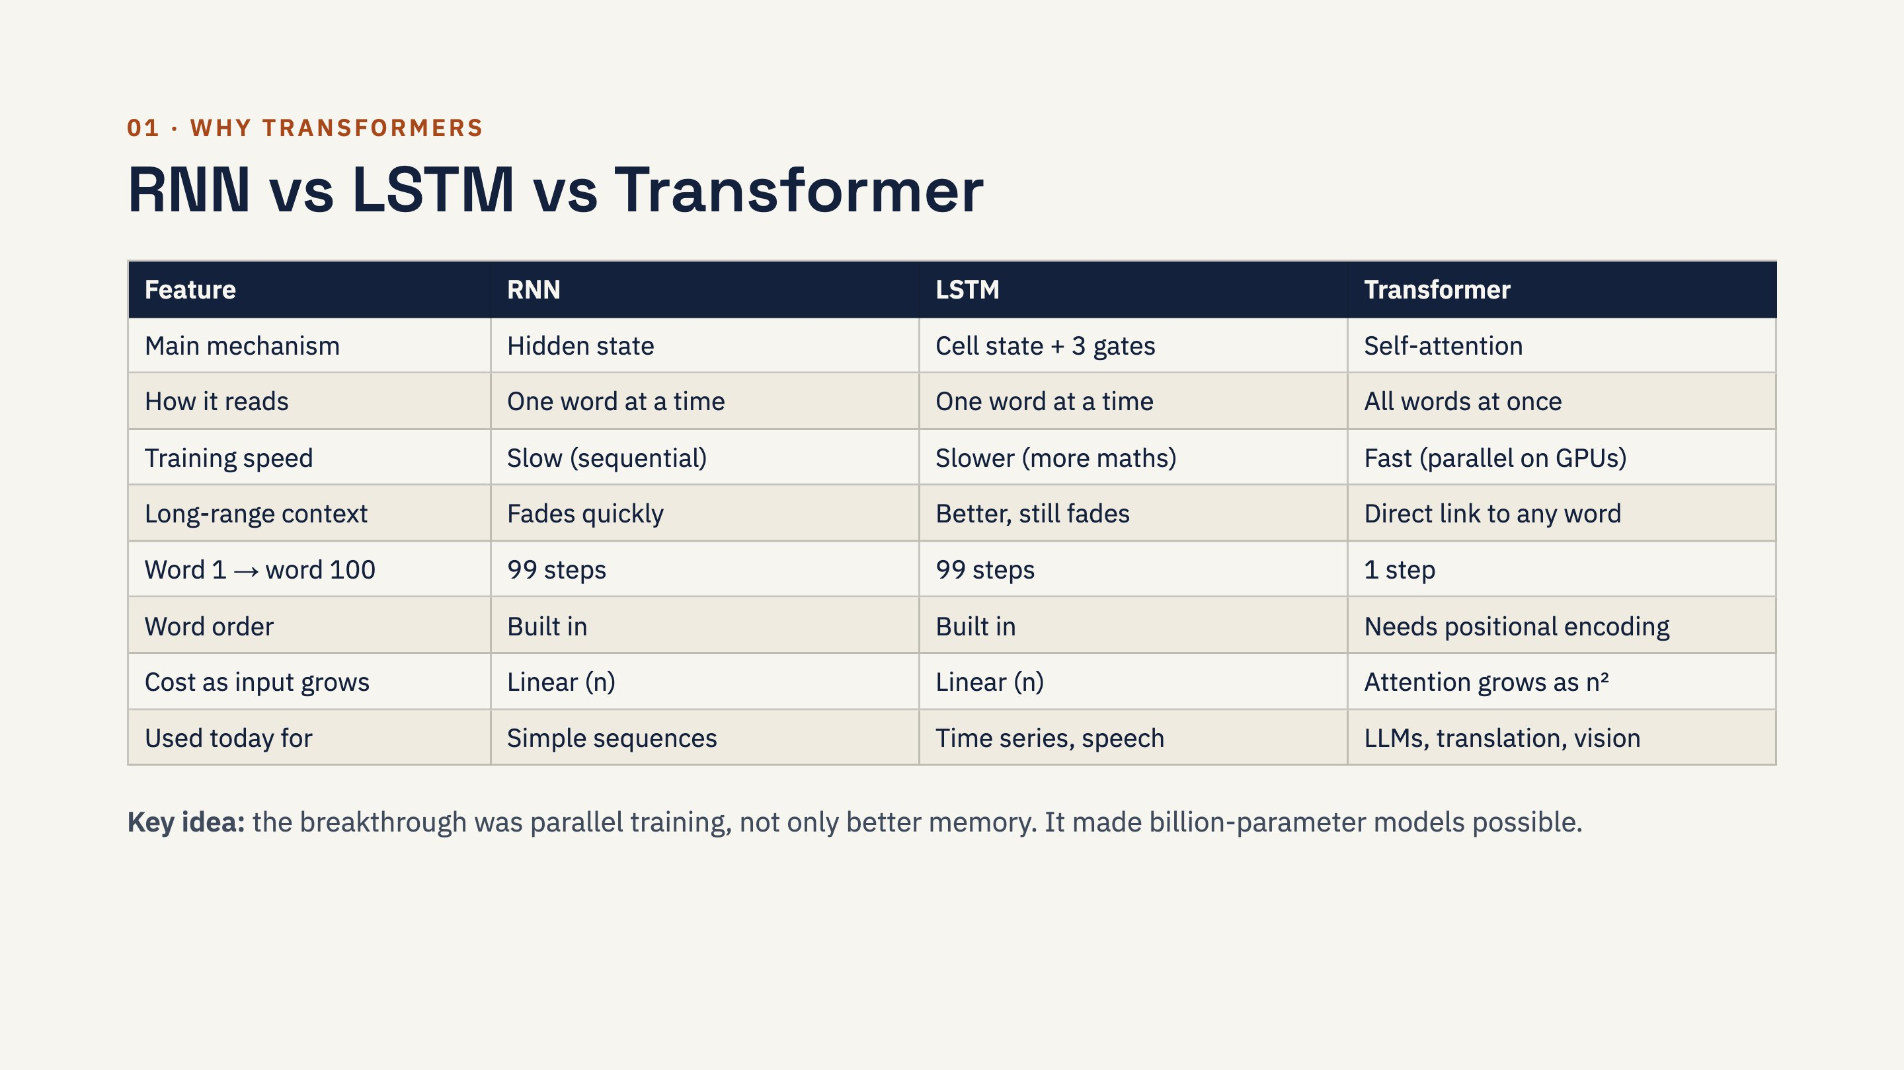
Notes:
Two nuances worth saying out loud. First, Transformers are parallel while reading, but they still generate one token at a time. Second, it is a trade-off: RNN and LSTM are cheap per step with fixed memory, while a Transformer's attention cost grows with length squared. LSTMs are still a sensible choice for small datasets, sensor data and small devices.

Slide 5
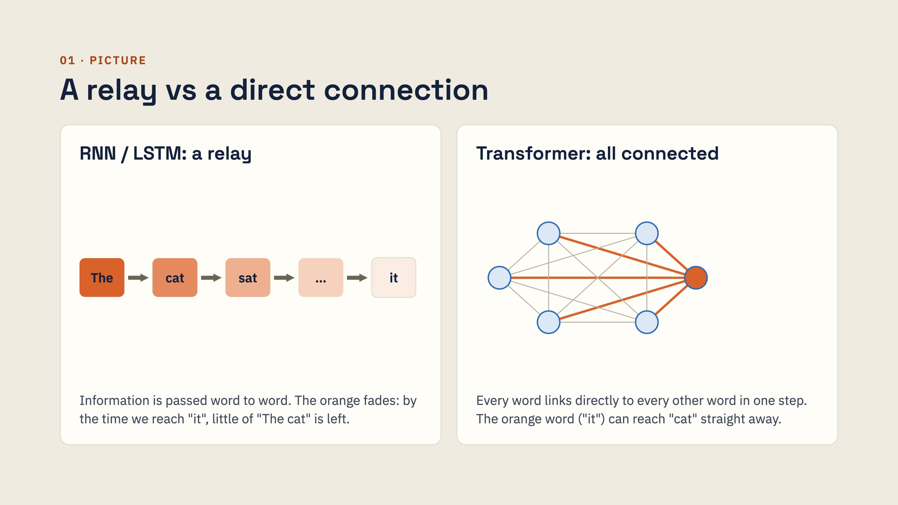
Notes:
Ask the class: if you had to pass a message along a line of 100 people, how much of it survives? That is the RNN. Now imagine everyone in a room can talk to everyone directly. That is attention. The price: with n words there are about n × n connections, which is why long inputs get expensive.

Slide 6
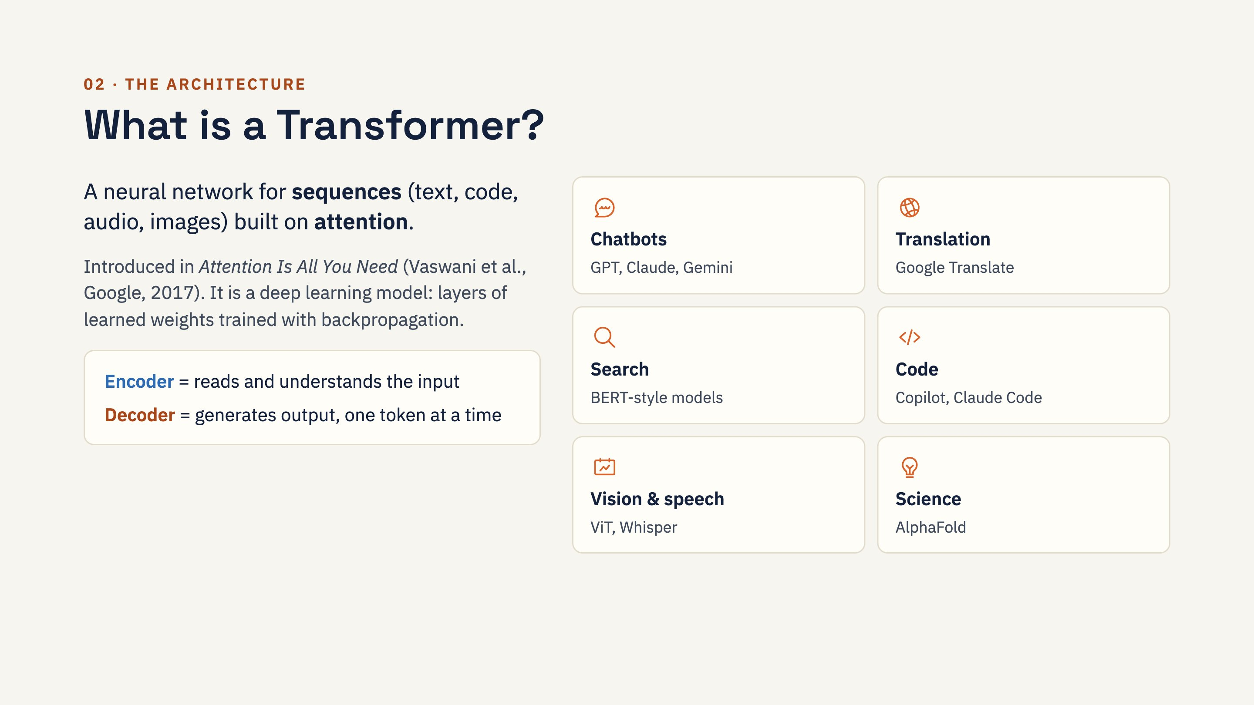
Notes:
Clear up a common confusion here: Hugging Face's Python library is called "transformers", but it is a library of ready-made Transformer models, not the architecture itself. This module teaches the architecture; Hugging Face appears in the hands-on part.

Slide 7
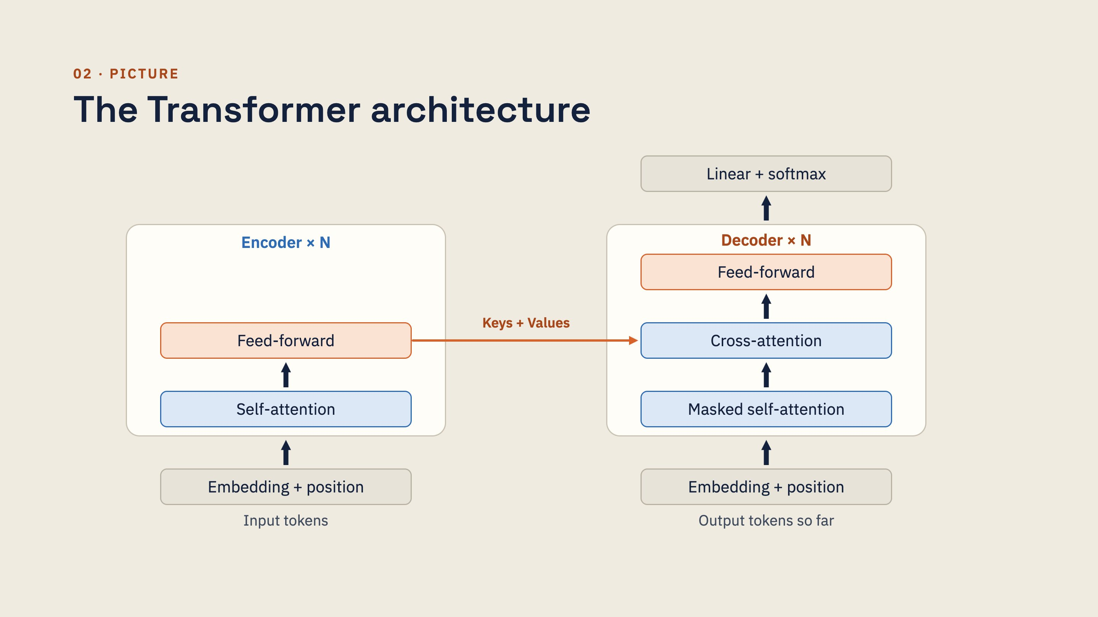
Notes:
Walk through translation: "I love India" goes in on the left; the encoder builds an understanding of it. The decoder writes the Hindi one token at a time: masked self-attention looks at what it has written so far, cross-attention looks at the encoder's output (orange arrow) to decide what to write next, feed-forward processes it, and linear + softmax gives a probability for every word in the vocabulary. Hidden in every block: residual connections and LayerNorm (shown later). N was 6 in the original paper; big models use 100+ layers.

Slide 8
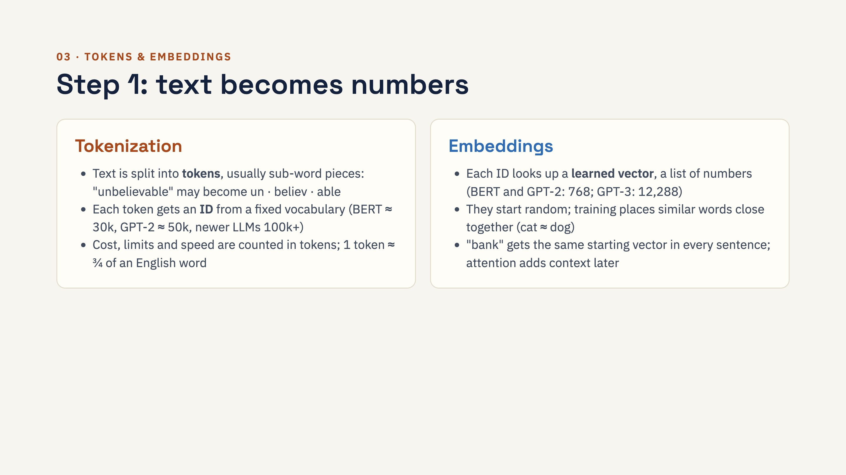
Notes:
Nuance: because models see word pieces, not letters, they struggle with tasks like counting letters in "strawberry", and numbers are split oddly. Hindi or Tamil text usually needs more tokens than English for the same meaning, so it costs more and fills the context window faster. The tokenizer must always match the model.

Slide 9
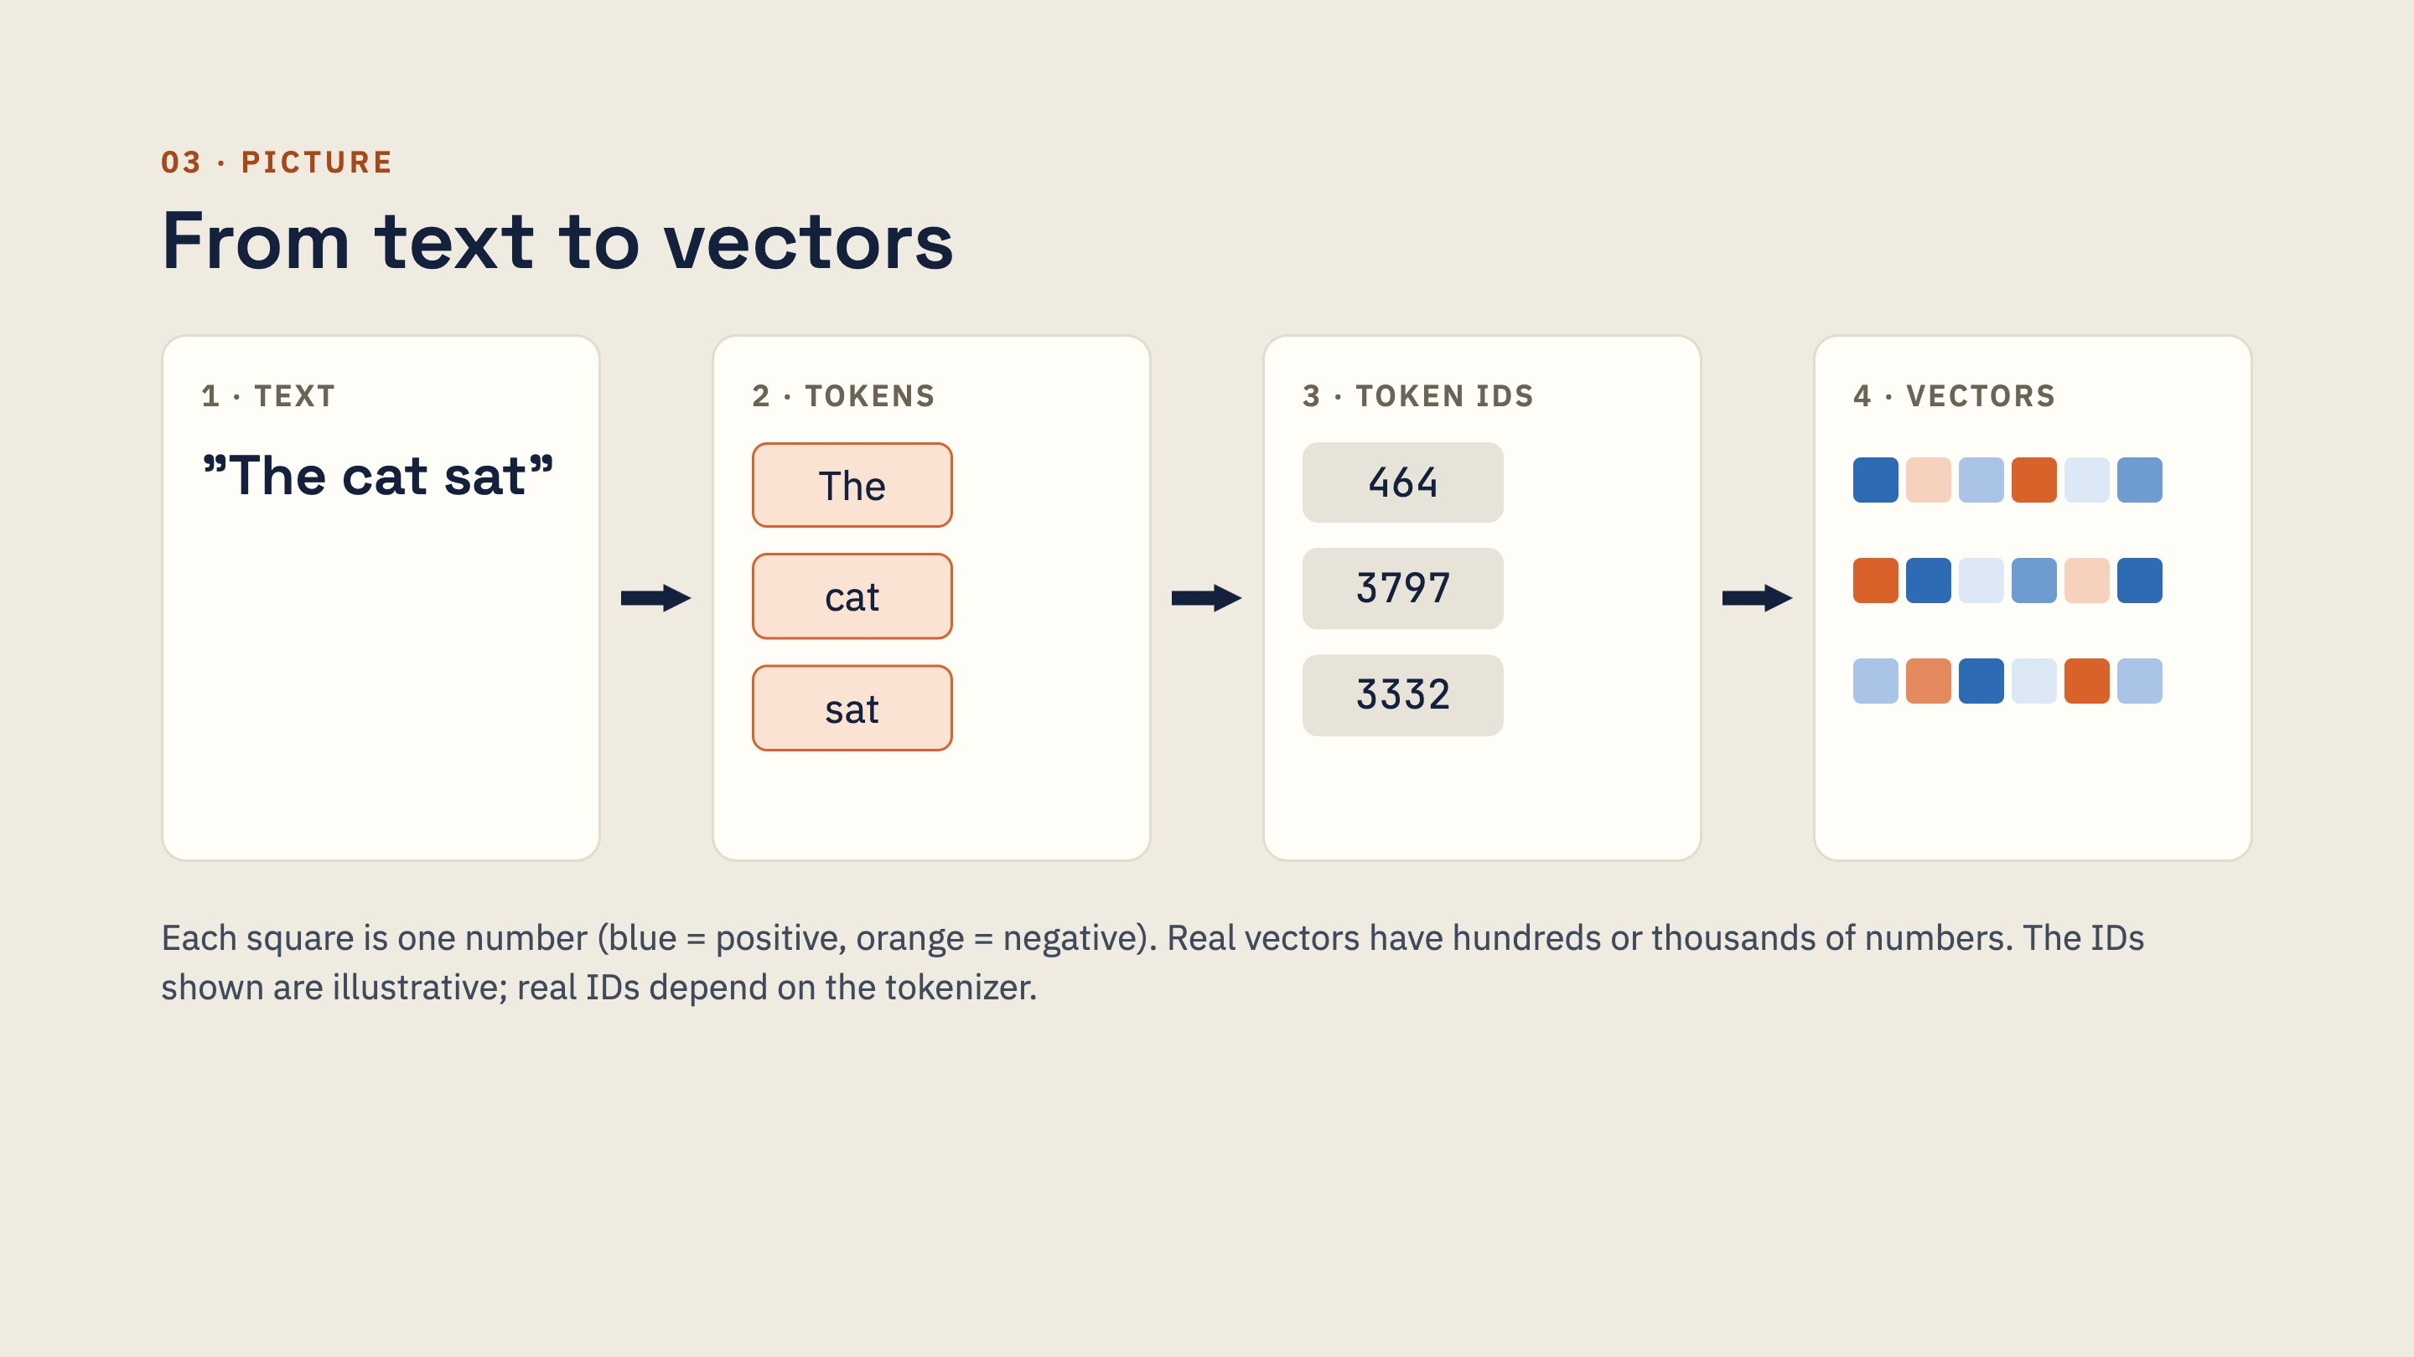
Notes:
An embedding lookup is simply picking a row from a learned table: one row per word in the vocabulary. It is mathematically the same as multiplying a one-hot vector by a weight matrix, just faster. The first notebook proves this in code.

Slide 10
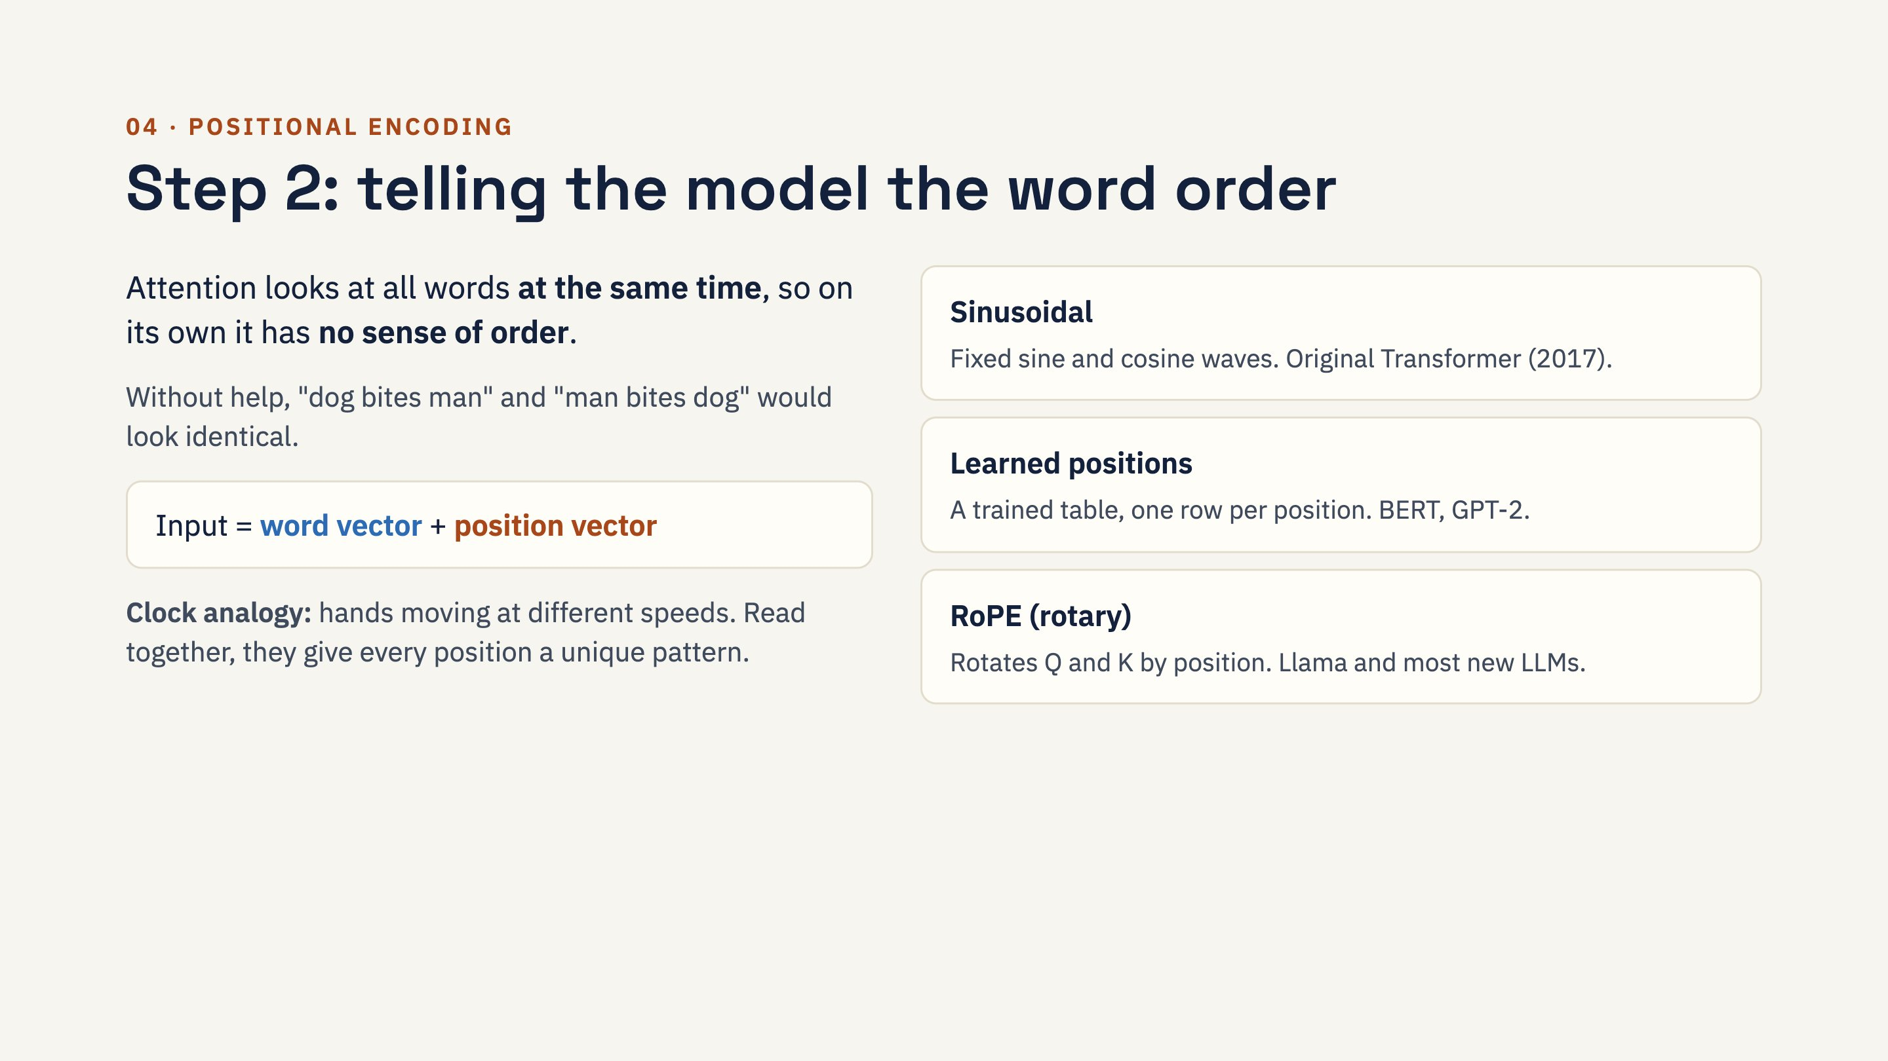
Notes:
Sinusoidal formula for reference: PE(pos, 2i) = sin(pos / 10000^(2i/d)), PE(pos, 2i+1) = cos(pos / 10000^(2i/d)). Values stay between -1 and 1, and need no training. Many context-window extensions (for example 4K to 128K tokens) work by adjusting the position scheme, especially RoPE.

Slide 11
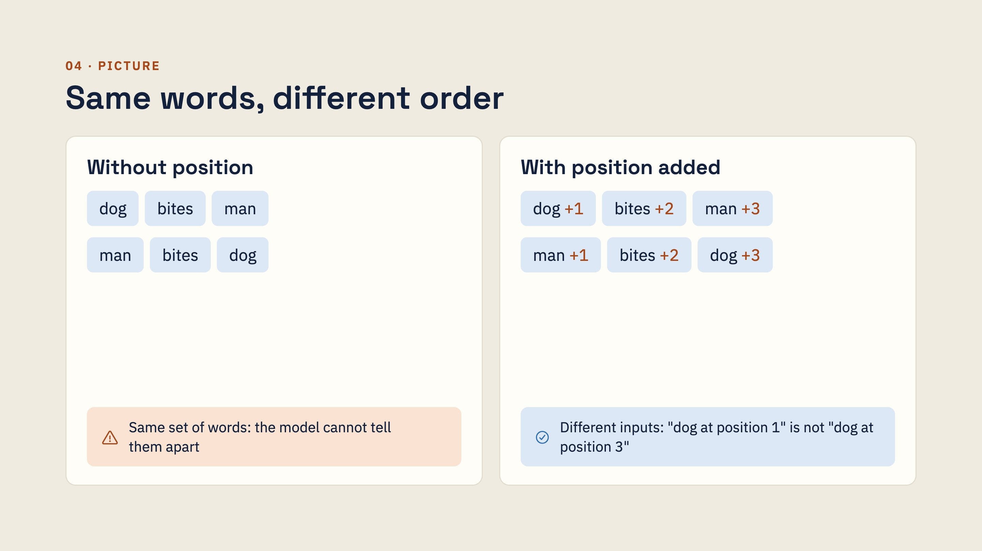
Notes:
The "+1, +2, +3" stands for adding a position vector, not literally adding a number. Exercise from the first notebook: remove positional encoding and retrain the sequence-reversal model. It can no longer reverse, because it no longer knows which digit came first.

Slide 12
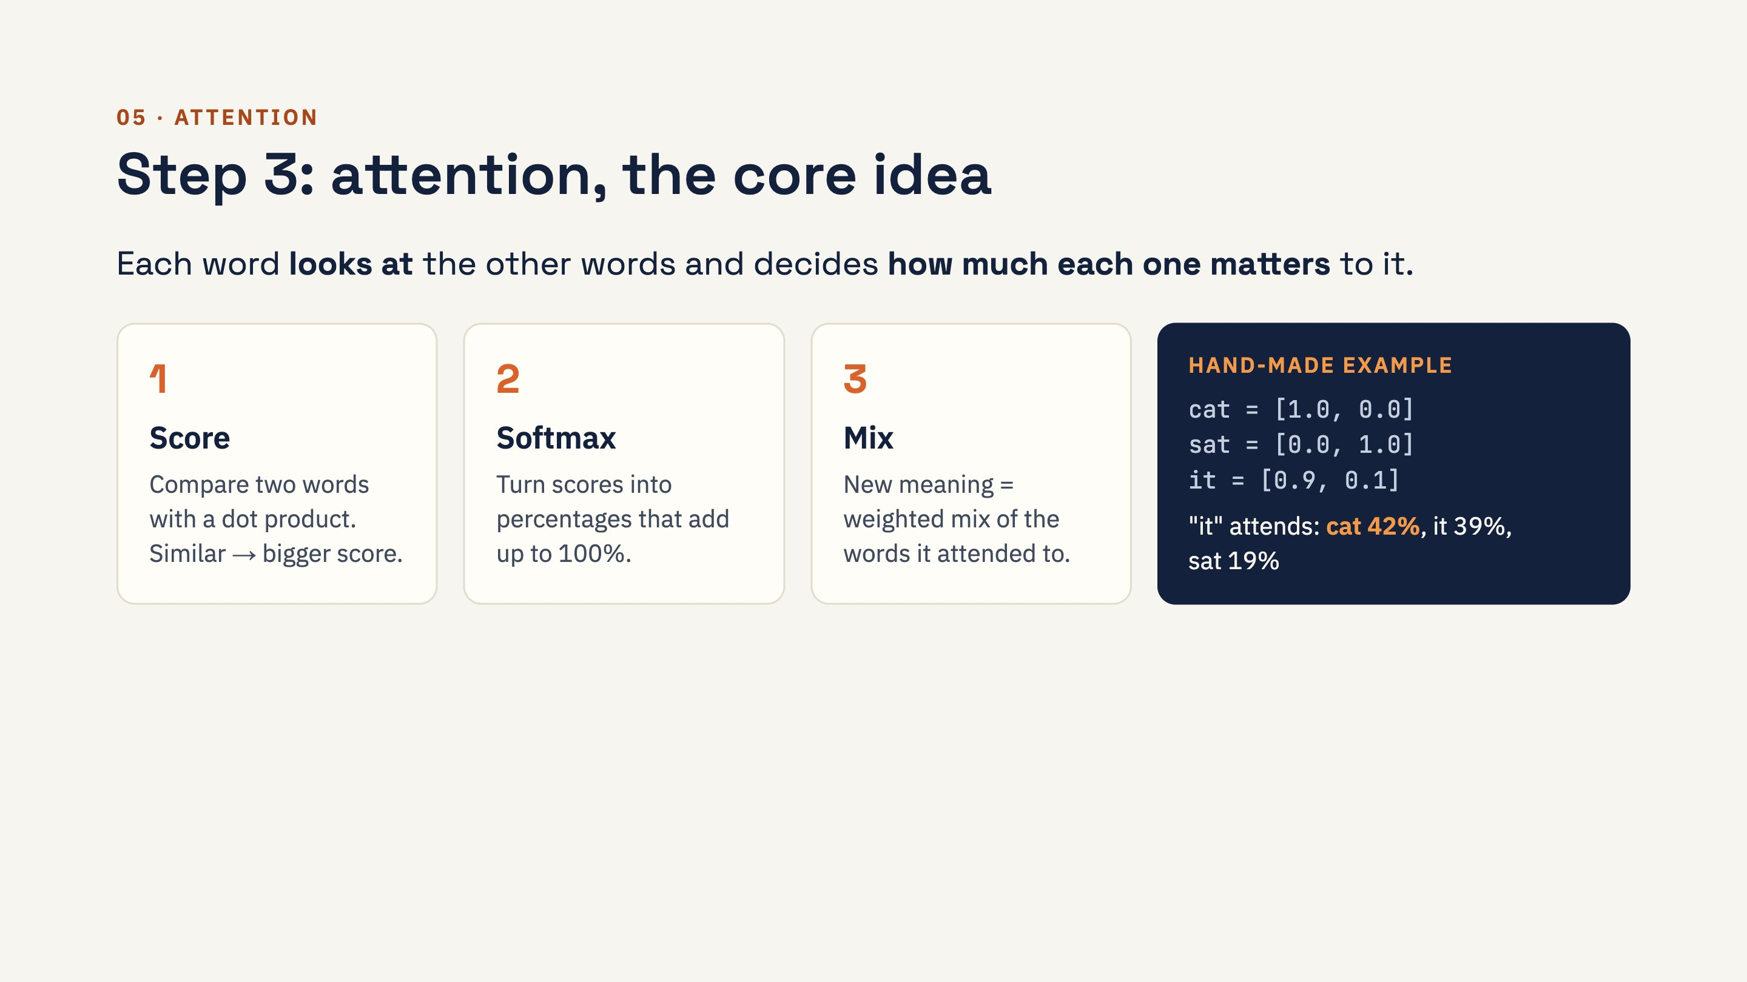
Notes:
The two numbers in the hand-made example are chosen by us to teach: number 1 means "is it an animal?", number 2 means "is it an action?". Scores for the "it" row: it·cat = 0.90, it·sat = 0.10, it·it = 0.82; softmax gives 42%, 19%, 39%. Real models learn hundreds of numbers per word, and their meanings are not labelled. Try changing "it" to [0.1, 0.9]: now it attends most to "sat".

Slide 13
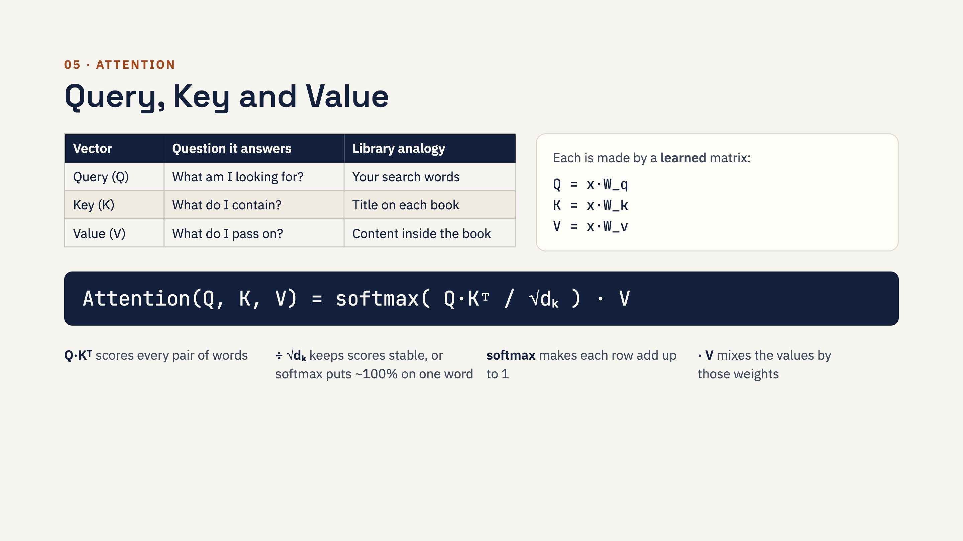
Notes:
Why three separate matrices? A word's role as a searcher differs from its role as something to be found: W_q lets "it" search for nouns while W_k lets "cat" advertise itself as one. Why divide by the square root of d_k? Dot products of long vectors are large; softmax of large numbers becomes nearly one-hot and gradients vanish, so training stalls. The notebook shows this: with d = 512, unscaled weights were [0, 0, 0, 0, 0, 1].

Slide 14
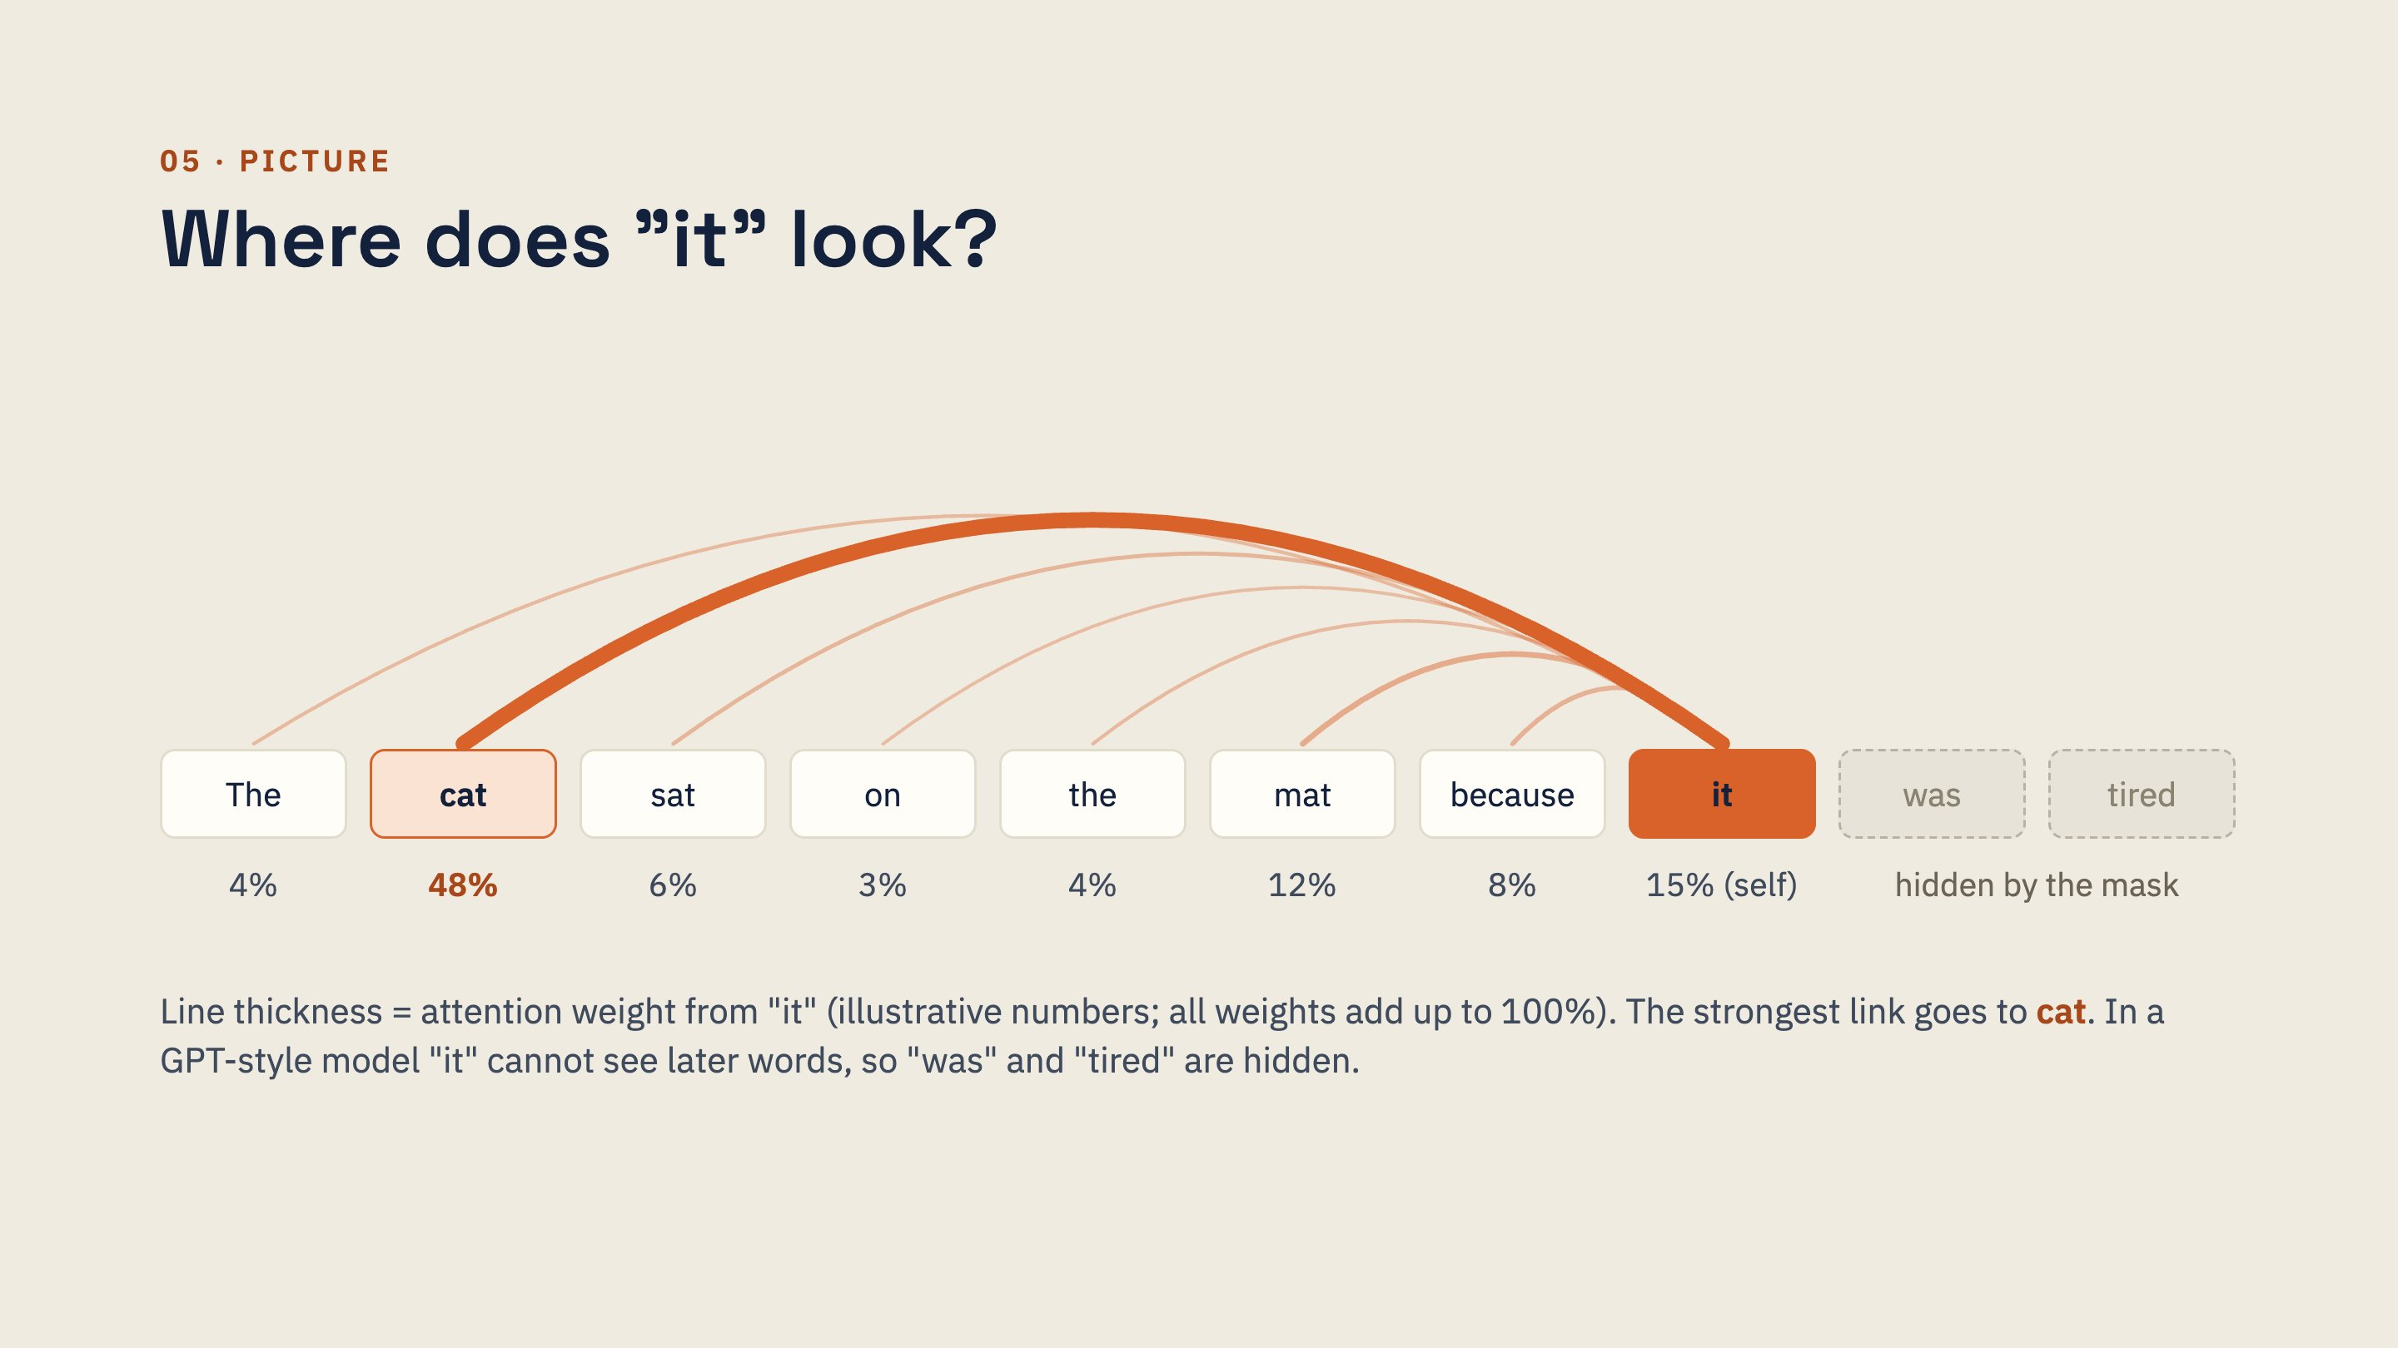
Notes:
Point out three things. One: every earlier word gets some weight; attention is a soft weighted average, not a single pointer. Two: the weights add up to 100%. Three: the later words are hidden by the causal mask in decoder models such as GPT and Claude. In an encoder such as BERT, "it" could also look right, at "was" and "tired". The numbers here are made up to show the idea; a real trained model's weights differ by layer and head.

Slide 15
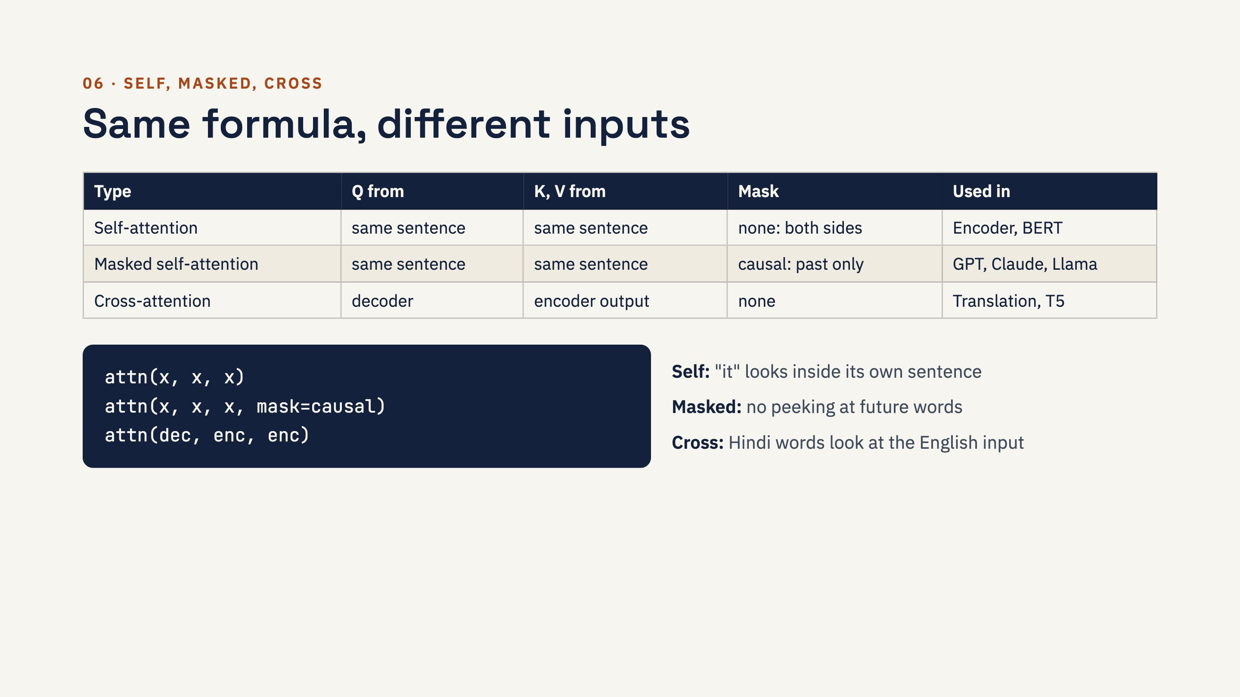
Notes:
History: attention was first added to RNN translation models in 2014 (Bahdanau et al.) as cross-attention between two sequences. The 2017 breakthrough was using self-attention to replace the RNN entirely. Modern chat LLMs are decoder-only: they have no cross-attention; the prompt and the answer are one sequence, read with masked self-attention. The causal mask applies to your prompt too, so word 5 of a prompt cannot see word 6.

Slide 16
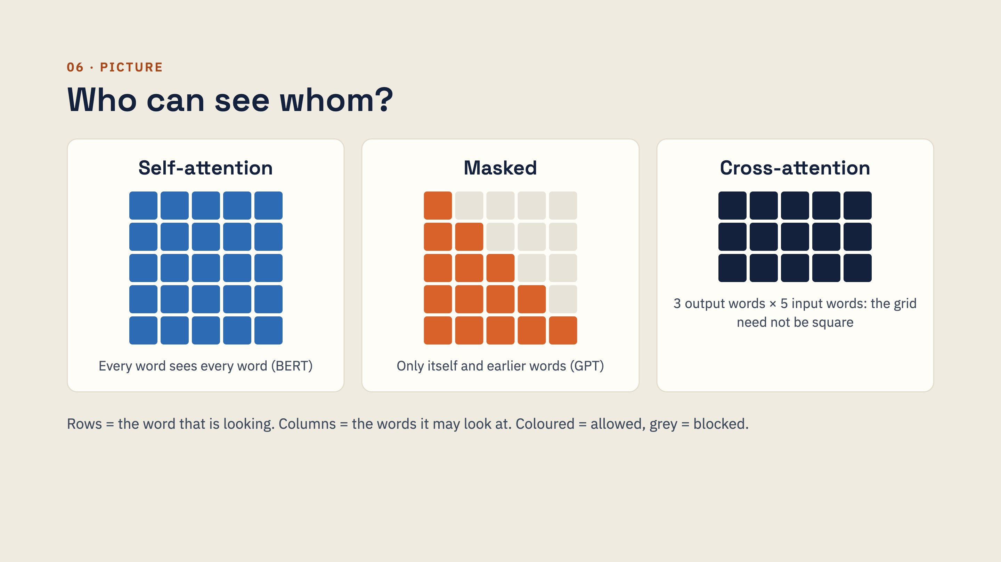
Notes:
The masked grid is exactly what torch.tril(torch.ones(n, n)) produces in the notebooks. In PyTorch's built-in nn.Transformer the convention is reversed (True or minus infinity means blocked), a very common bug. Cross-attention grids are output length by input length, which is why translation works between sentences of different lengths.

Slide 17
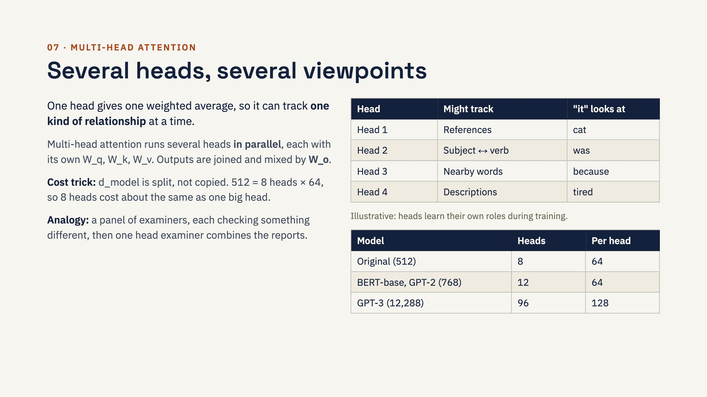
Notes:
Nuances: nobody assigns roles to heads; "head 3 tracks pronouns" is something researchers discover afterwards, and many heads turn out to be redundant and can be pruned. Every layer has its own heads: BERT-base has 12 layers × 12 heads = 144. Newer LLMs often share keys and values between heads (multi-query or grouped-query attention) to save memory during generation. Multi-head works with self, masked and cross attention alike.

Slide 18
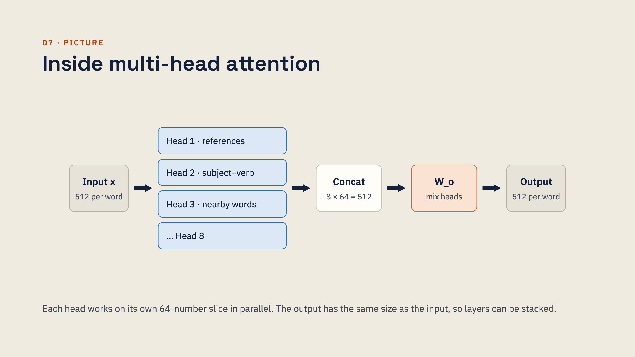
Notes:
In code the split is just reshaping: Q.view(batch, seq, 8, 64).transpose(1, 2). In the beginner notebook we keep it simpler: a Python list of Head objects joined with torch.cat. The built-in PyTorch layer is nn.MultiheadAttention(embed_dim=512, num_heads=8, batch_first=True).

Slide 19
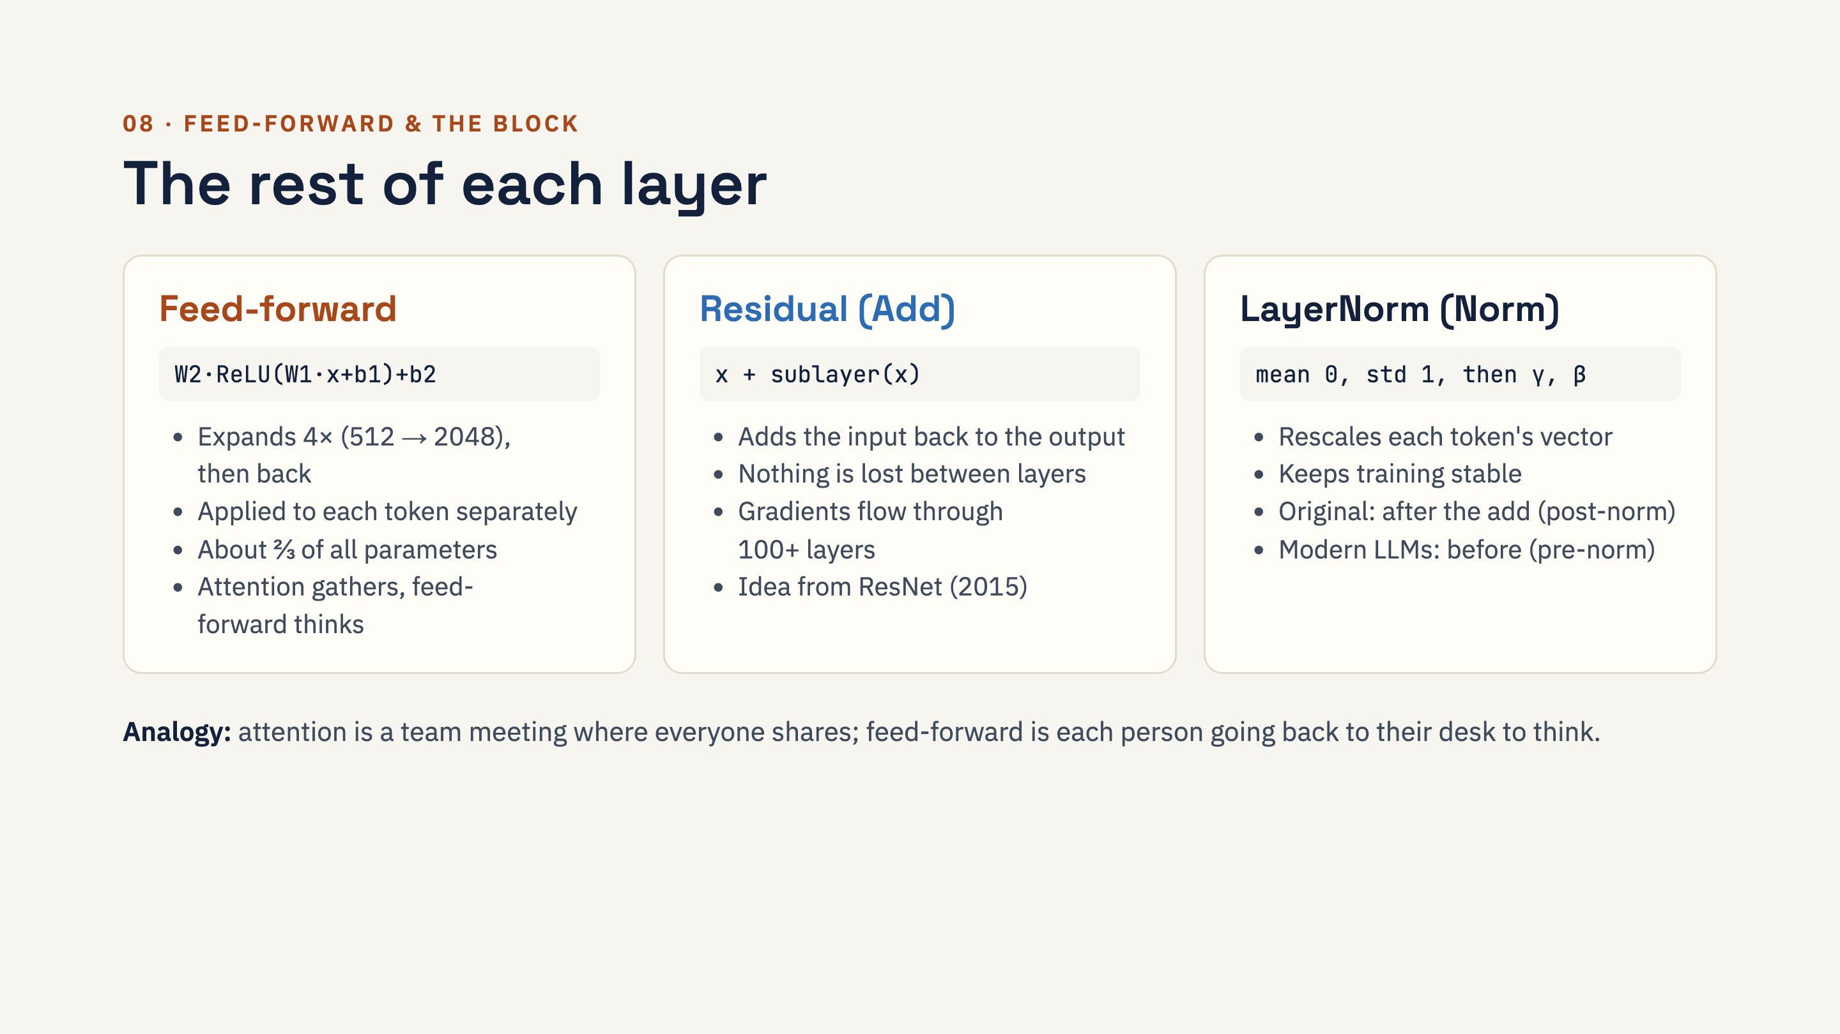
Notes:
Without the ReLU (or GELU in BERT and GPT) non-linearity, stacked layers would collapse into one big linear function. Research suggests feed-forward layers act like key-value memories that store facts learned in training. Mixture-of-Experts models replace one feed-forward layer with many "expert" ones and run only a few per token. LayerNorm, not BatchNorm, because it works per token and does not depend on batch size or sentence length.

Slide 20
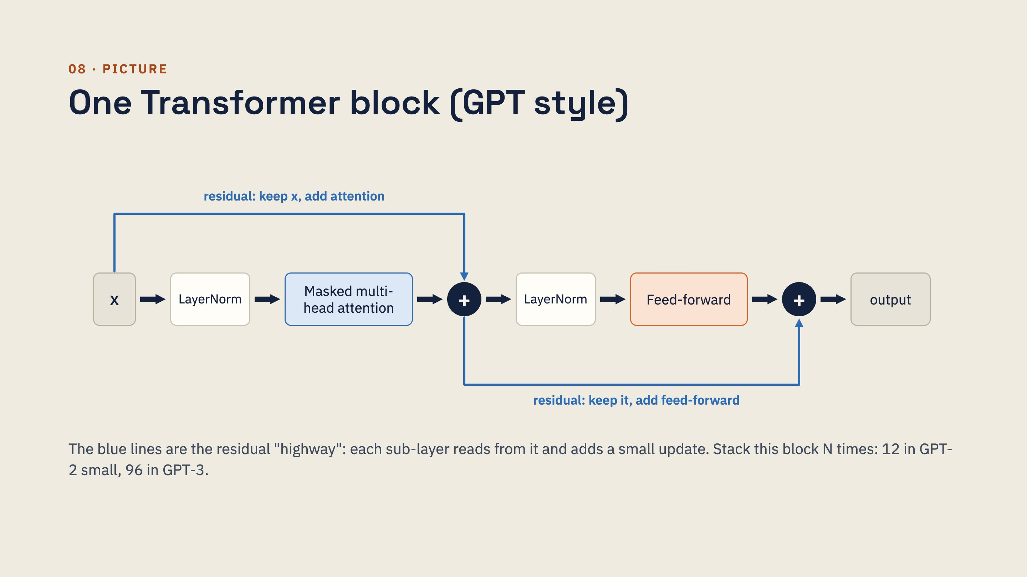
Notes:
Read it left to right: normalise, let words share information through attention, add the result back to x, normalise again, let each word think through feed-forward, add back again. This is the pre-norm layout used by GPT-2 and most modern LLMs; the original 2017 paper normalised after each add instead. The output has the same shape as x, which is why blocks can be stacked.

Slide 21
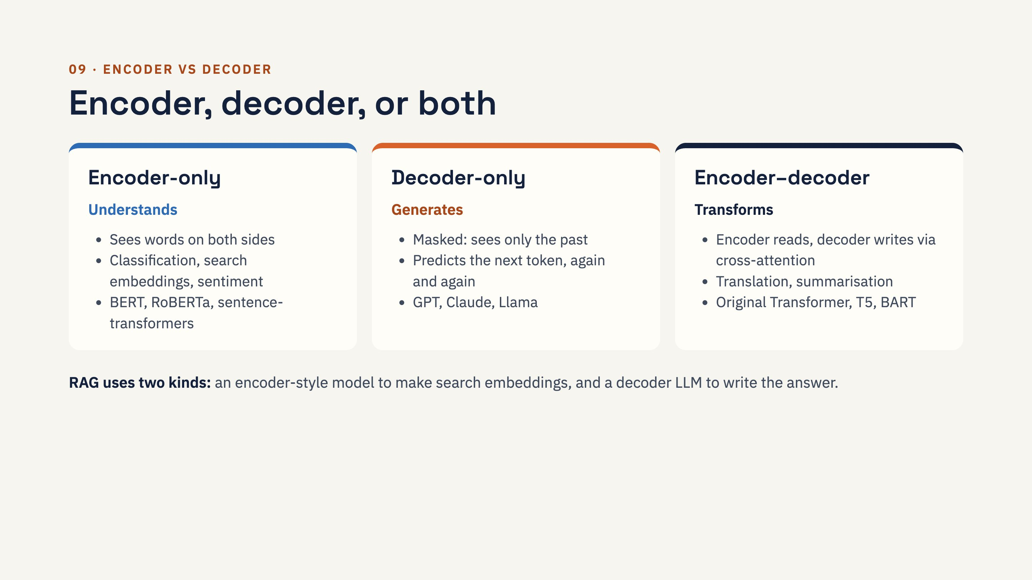
Notes:
Analogy: the encoder is a reader who summarises a book in their head; the decoder is a writer who writes one word, then picks the next. BERT sees both directions, so it is great at understanding but was not trained to write left to right. Hands-on: BERT fill-in-the-blank ("The cat sat on the [MASK]") versus GPT-2 text generation shows the difference instantly.

Slide 22
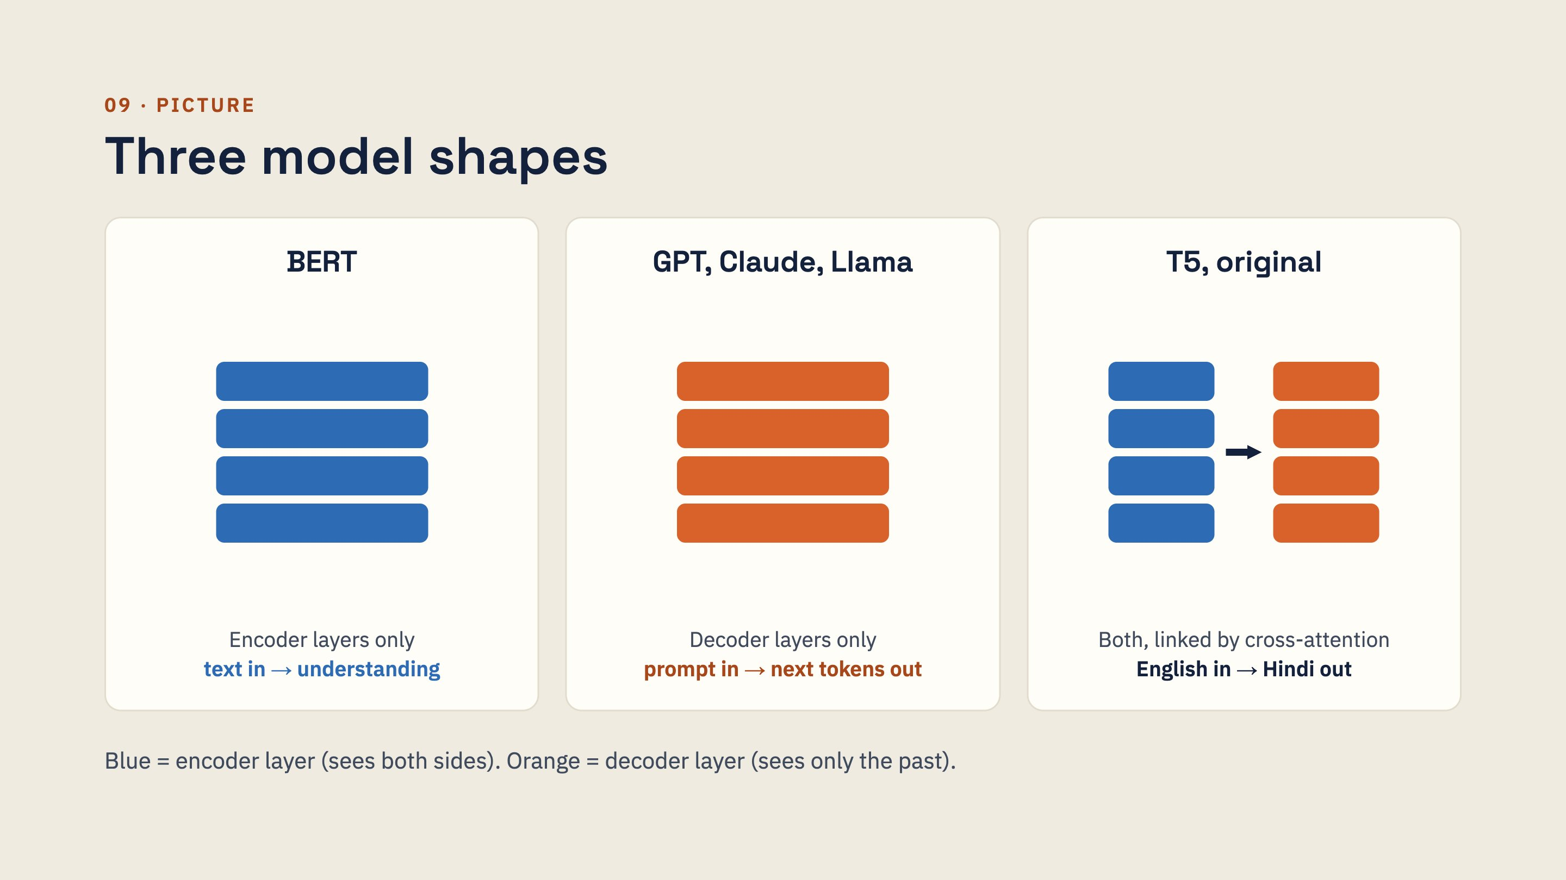
Notes:
Ask: is ChatGPT an encoder or a decoder? Decoder-only. Is the embedding model in a RAG pipeline an encoder or a decoder? Usually an encoder. Which shape would you pick for translating English to Hindi? Encoder-decoder, though large decoder-only LLMs now translate well too.

Slide 23
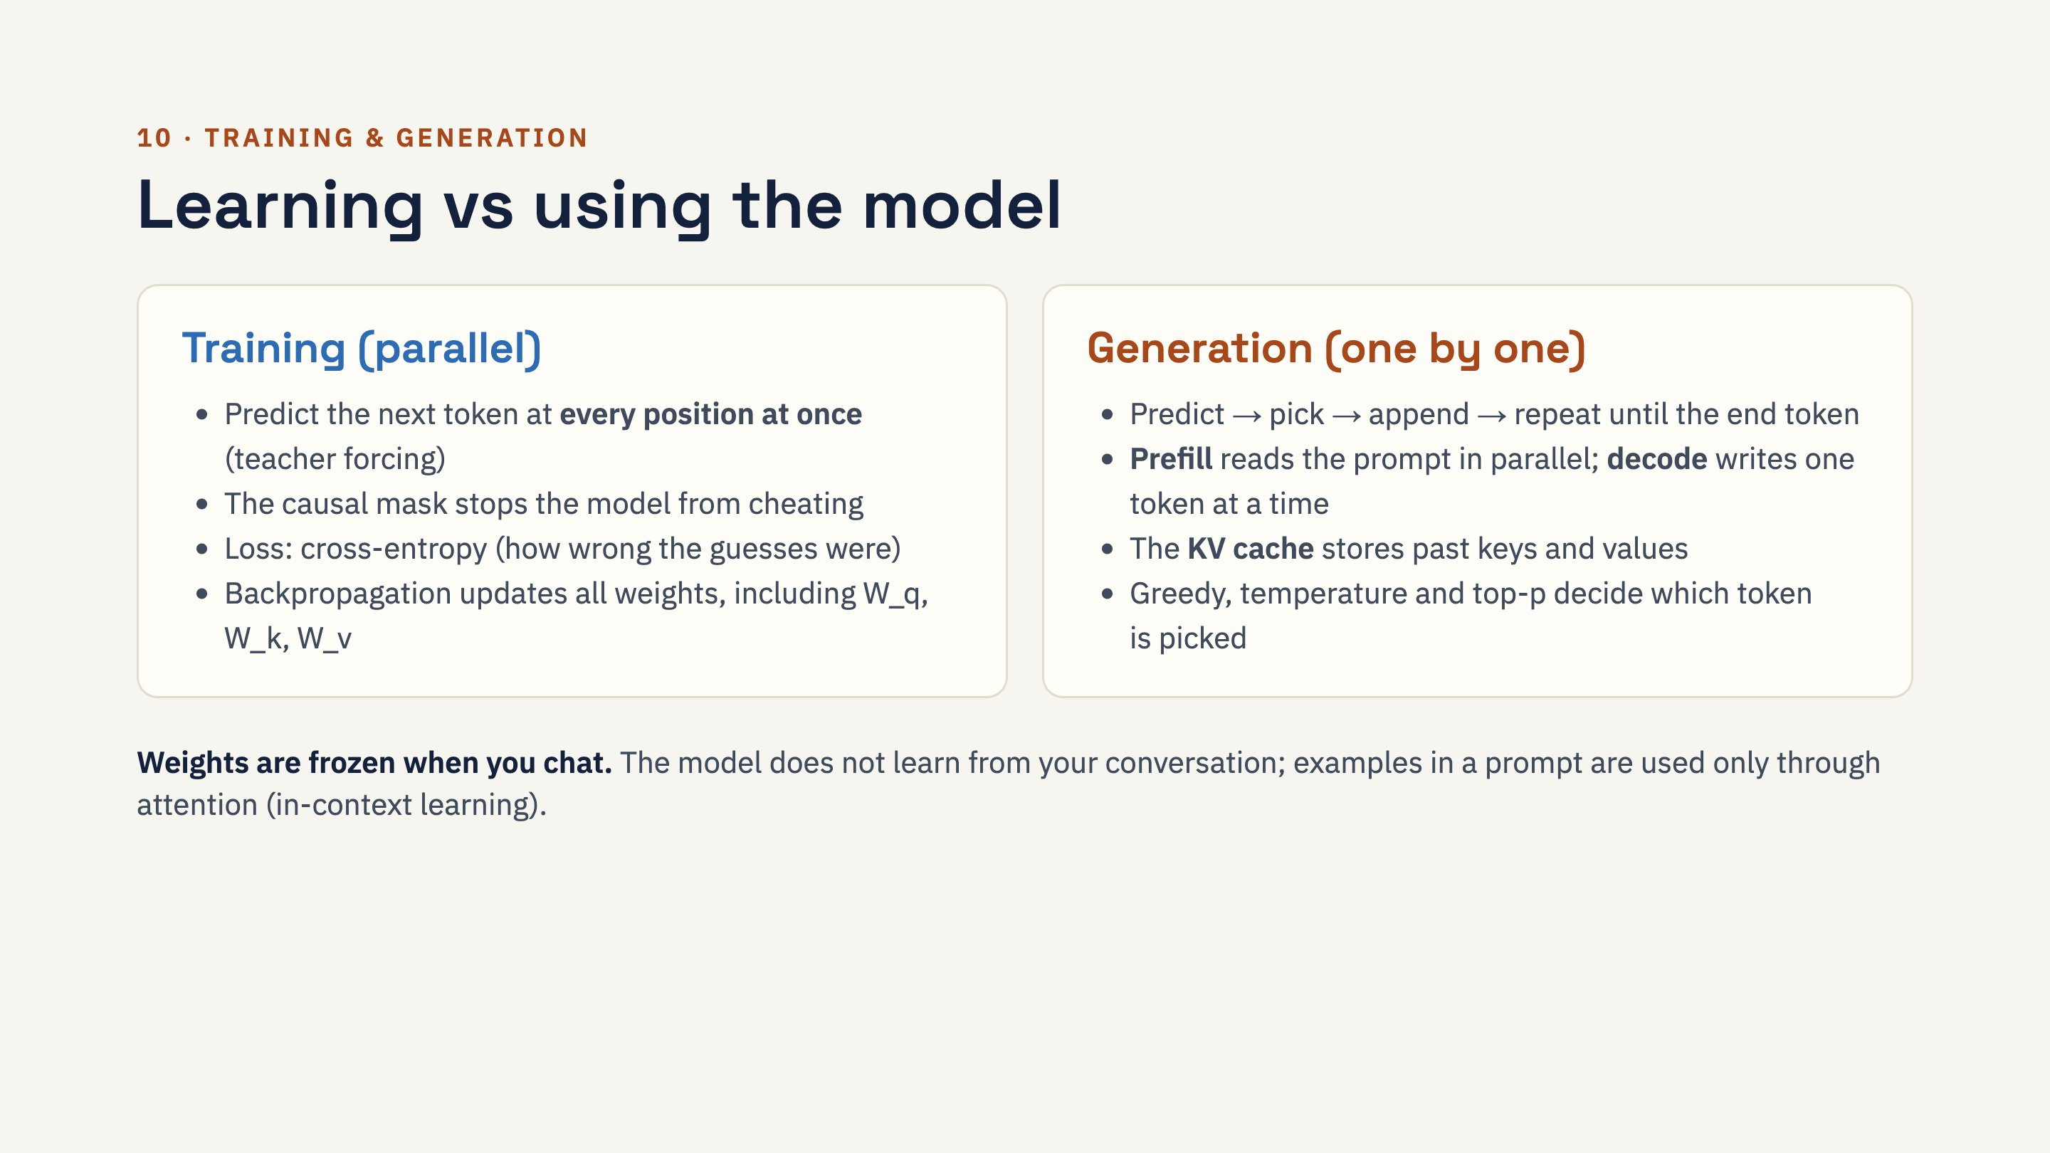
Notes:
This is the same loop ChatGPT and Claude use. In the first notebook, the from-scratch Transformer learns to reverse sequences of digits and reaches about 99.8% accuracy in a couple of minutes on a CPU. Long answers are slow because decode is sequential; long prompts are much faster per token because prefill is parallel.

Slide 24
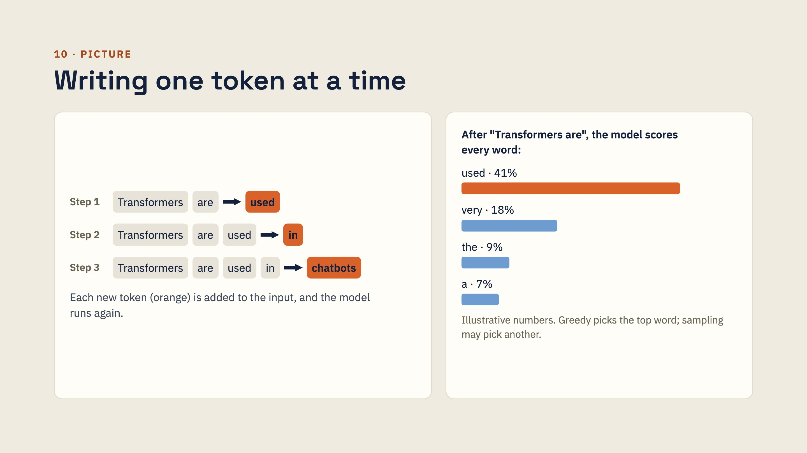
Notes:
Connect to temperature: a low temperature makes the tallest bar even taller (safe, repetitive); a high temperature flattens the bars (more varied, riskier). Top-p keeps only the smallest set of top words whose probabilities add up to p, then samples among them. The model outputs probabilities; the decoding settings decide the actual words.

Slide 25
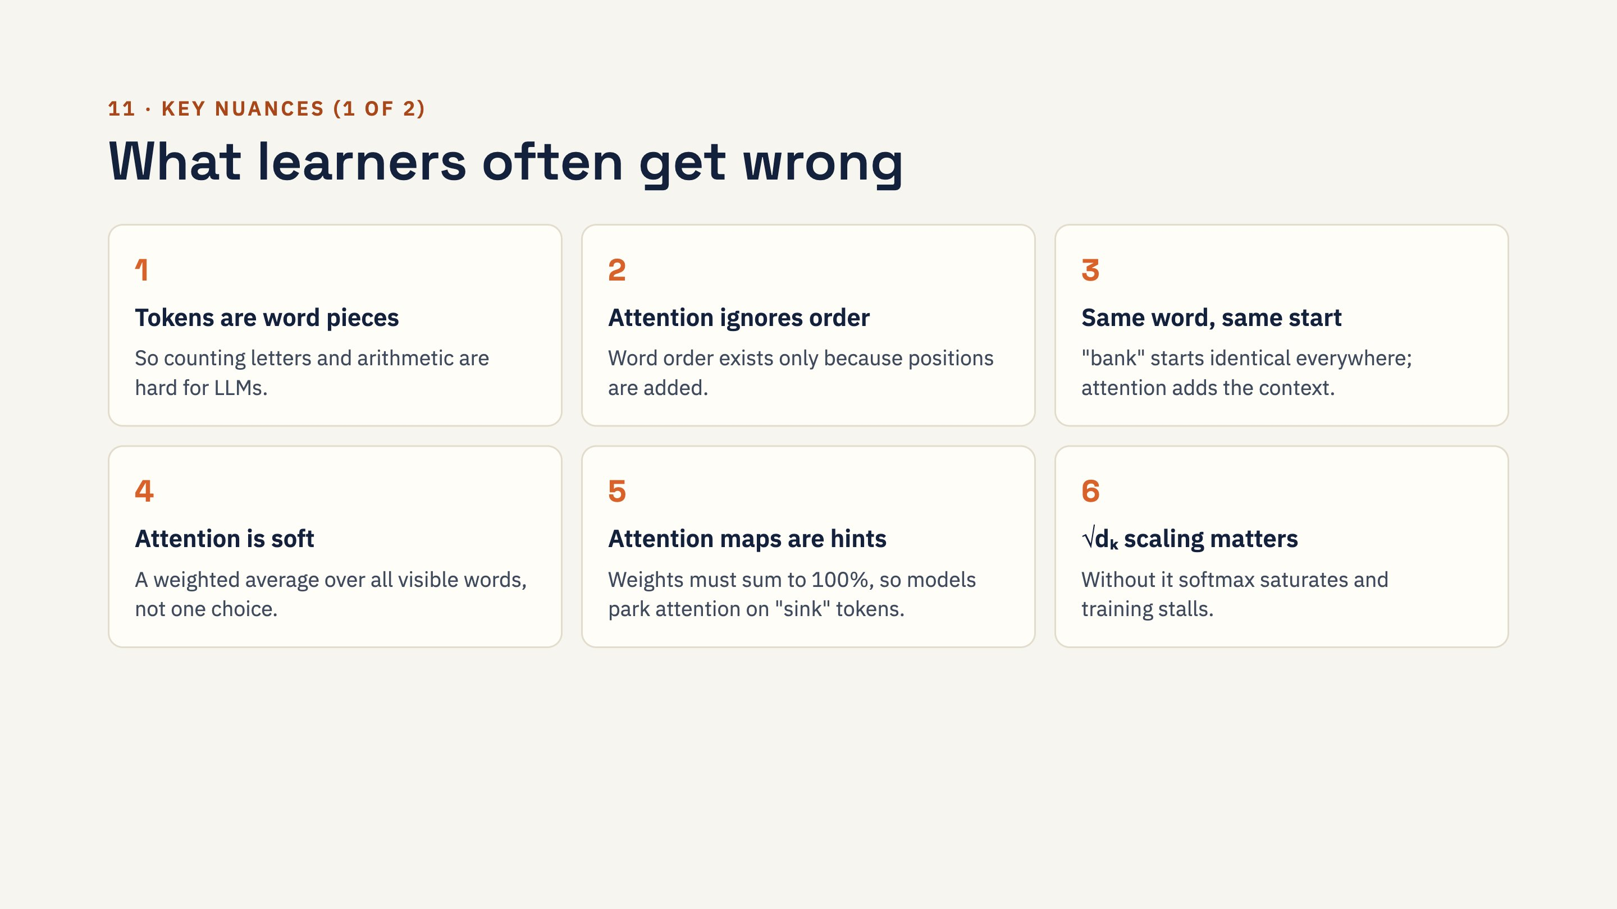
Notes:
On nuance 5: when nothing is relevant, models often dump attention on the first token or punctuation (attention sinks), so a bright spot does not always mean "important". The final answer also depends on dozens of layers, many heads and the feed-forward layers, so a single attention map is never a full explanation.

Slide 26
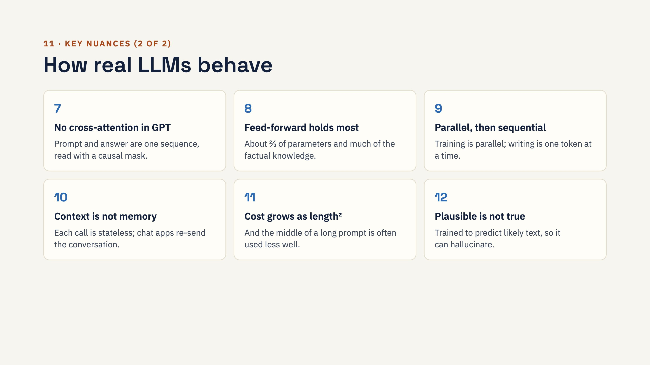
Notes:
Practical tie-ins for RAG builders: because of nuance 11 ("lost in the middle"), place the most relevant chunks near the question and do not stuff in too many. Because of nuance 12, RAG helps: it puts real facts into the context for attention to use. Because of nuance 10, the model never learns from your chat; its weights are frozen at inference time.

Slide 27
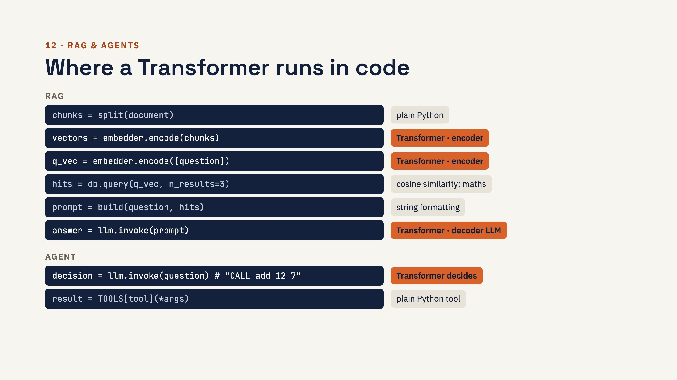
Notes:
Where it physically runs: SentenceTransformer(...).encode() or a Hugging Face pipeline runs the Transformer on your own computer. An API call (OpenAI, Claude, Gemini) sends text to the company's servers, where the Transformer runs. In our tiny agent notebook the exact line is scores = model(x)[0, -1] inside generate(). An agent usually runs the LLM once per loop: three tool calls usually means four LLM calls, three decisions plus the final answer.

Slide 28
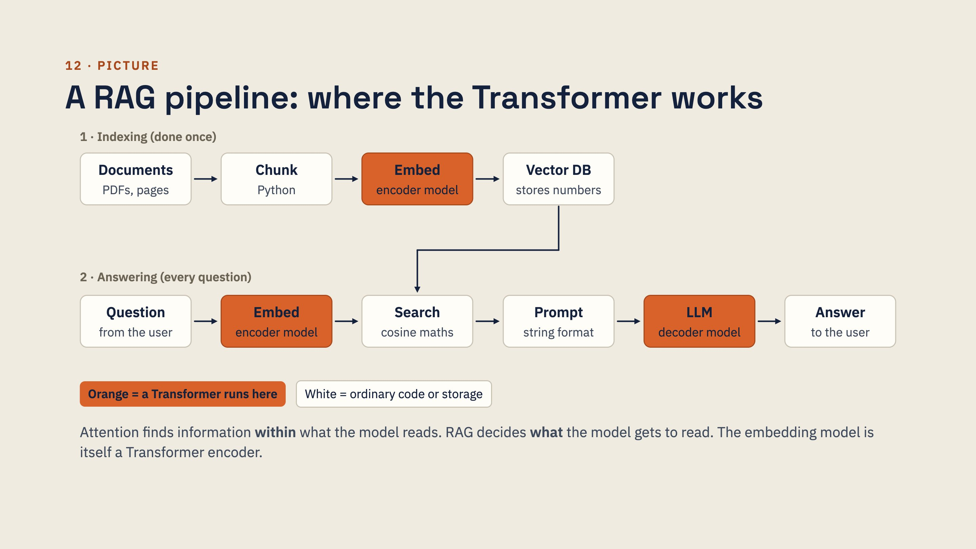
Notes:
Both Embed boxes must use the same embedding model, so the question and the chunks land in the same "meaning space". Vector search is not a Transformer: it only compares numbers. The final LLM step then uses self-attention to connect the question to the right parts of the retrieved text.

Slide 29
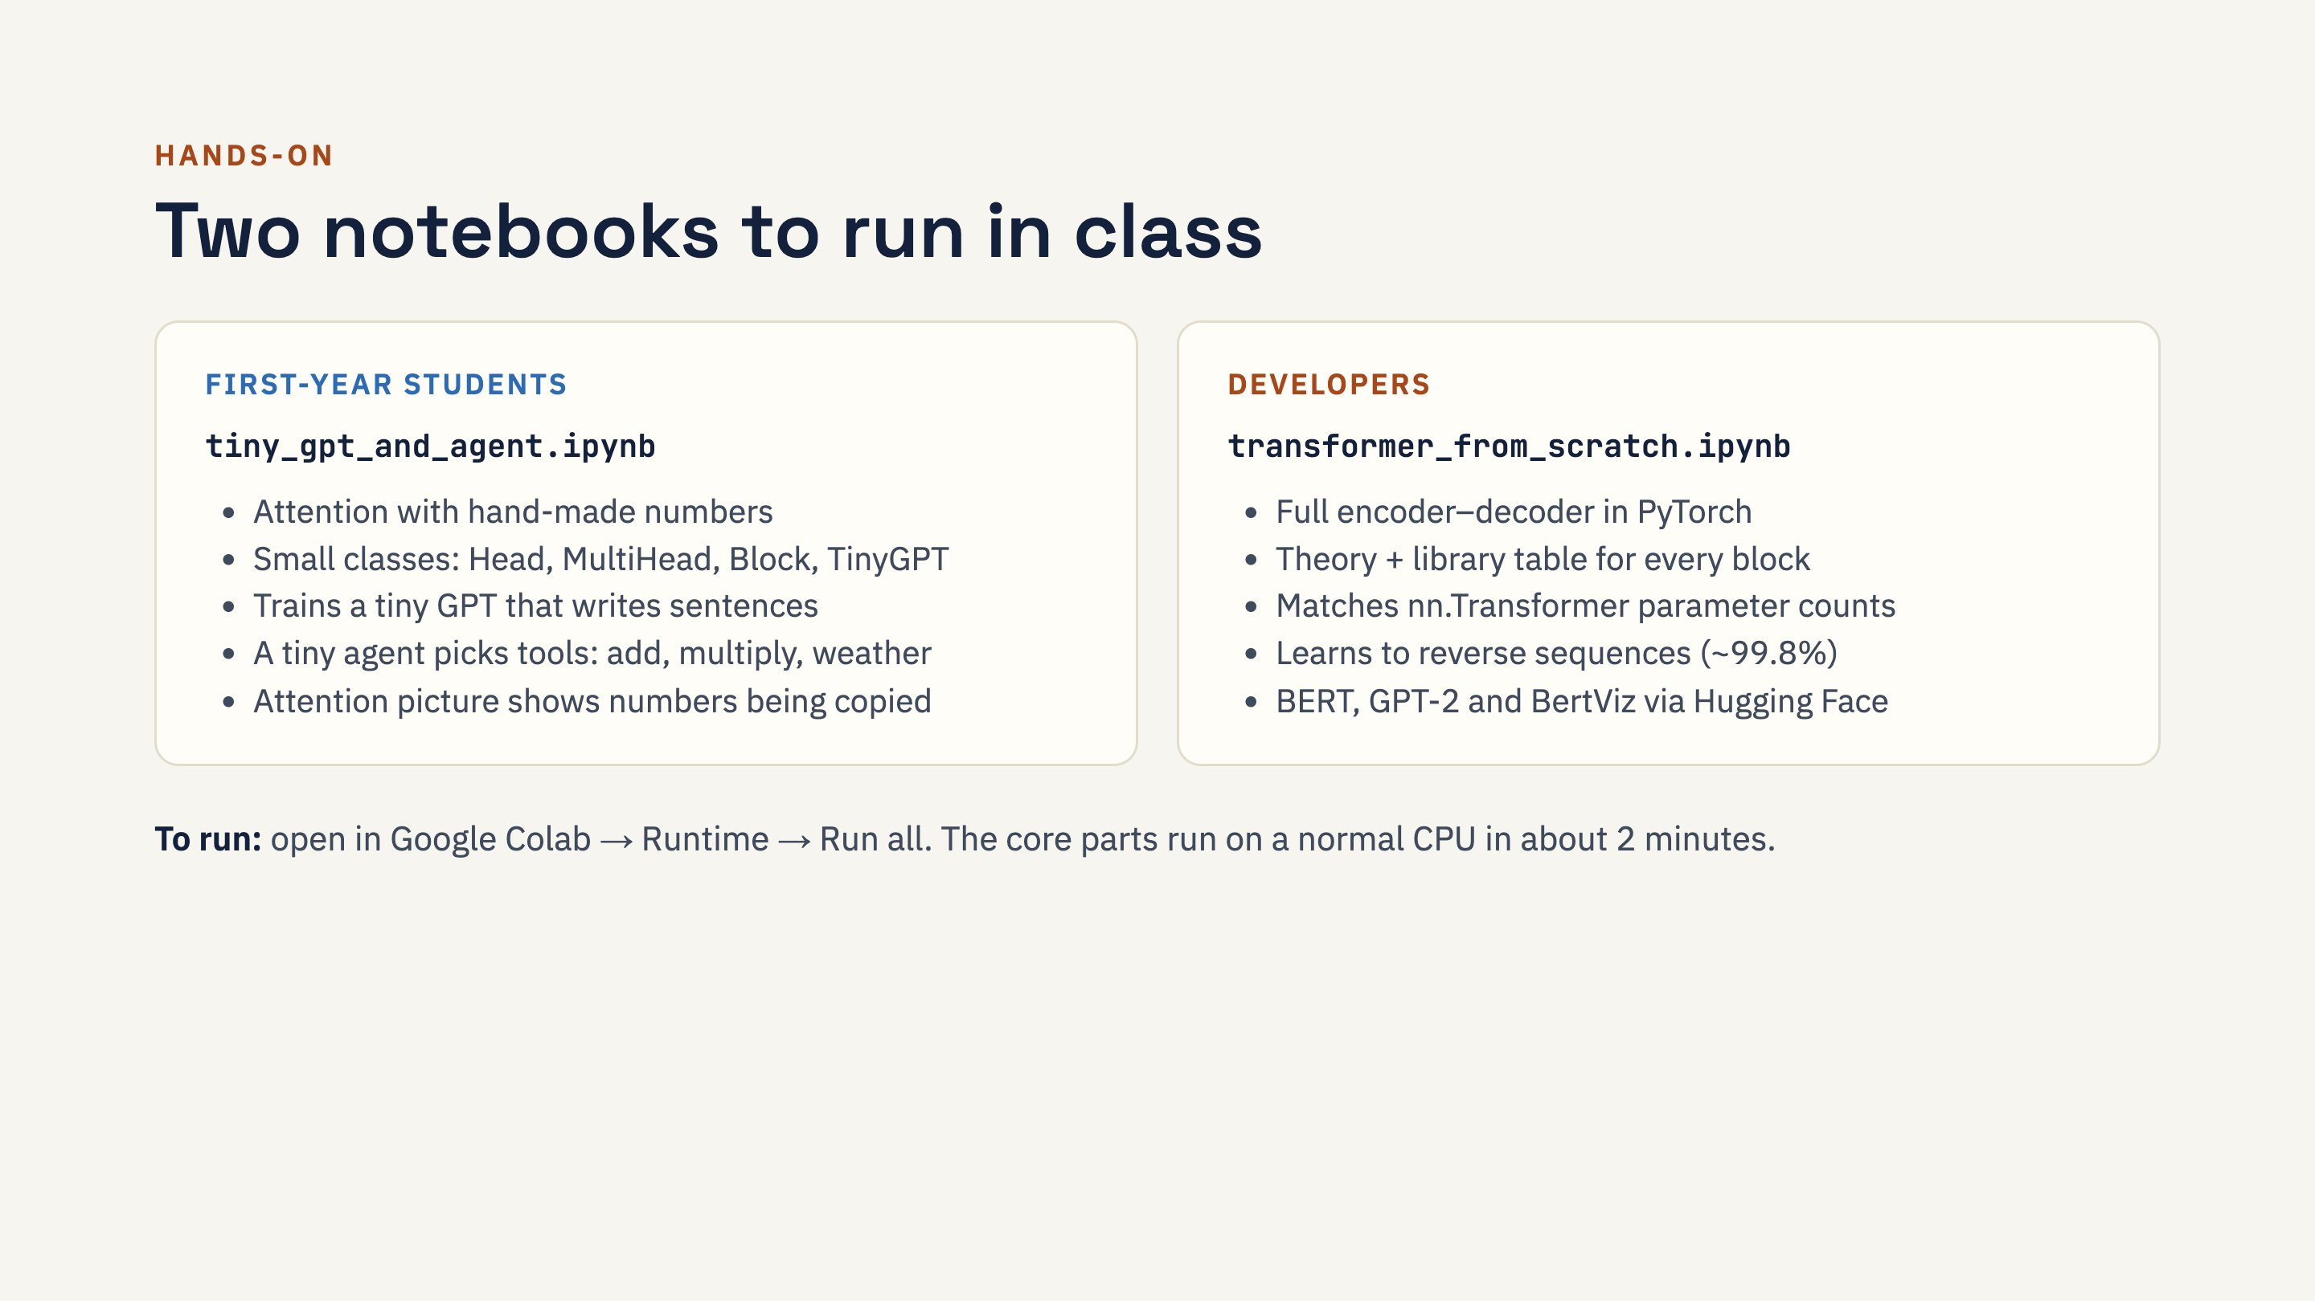
Notes:
The from-scratch notebook's Hugging Face part needs internet to download models. Suggested exercises: remove the causal mask and see generation break; remove positional encoding and see sequence reversal fail; add a subtract tool to the tiny agent; ask the agent "what is 25 plus 3" and explain why it fails (its training numbers only go up to 20).

Slide 30
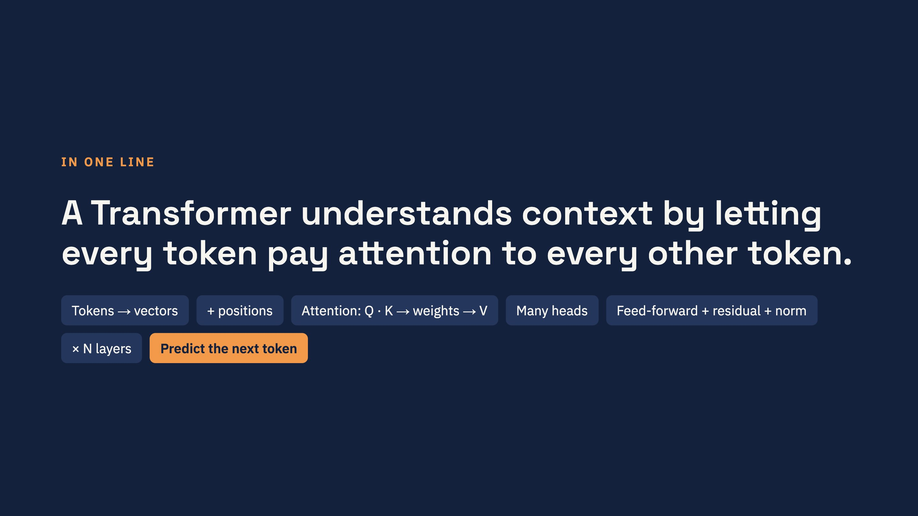
Notes:
Recap the flow once more, pointing at each chip: text becomes tokens and vectors, positions are added, attention lets tokens share information, several heads look in different ways, feed-forward processes each token, residuals and LayerNorm keep training stable, the block repeats N times, and a decoder model finally predicts the next token, again and again.

Slide 31

Notes:
Use these for a quick quiz at the end of the session or at the start of the next one. Questions go roughly in the order of the module: basics, input, attention, architecture, training and generation, then nuances, RAG and agents.

Slide 32
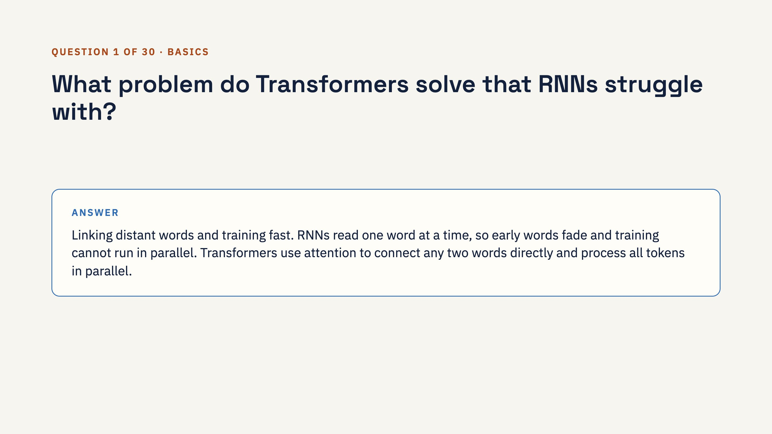
Notes:
Ask the class first, then click to reveal the answer.

Slide 33
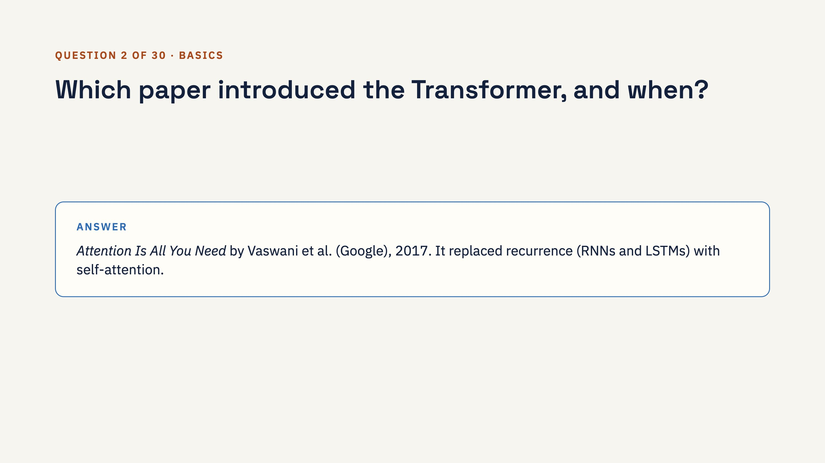
Notes:
Ask the class first, then click to reveal the answer.

Slide 34
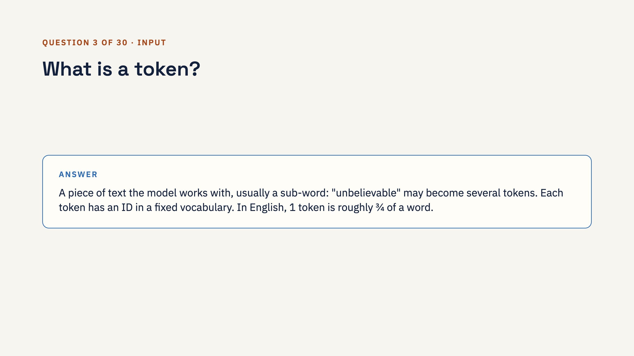
Notes:
Ask the class first, then click to reveal the answer.

Slide 35
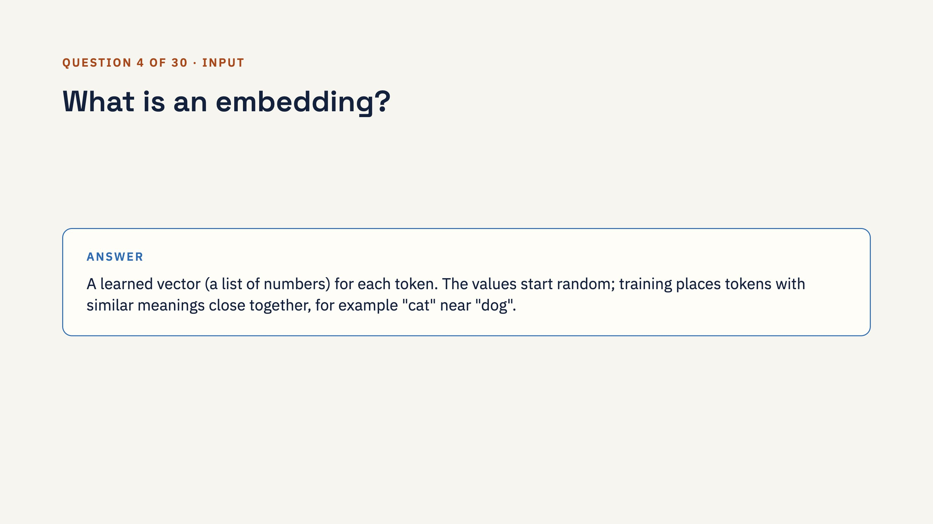
Notes:
Ask the class first, then click to reveal the answer.

Slide 36
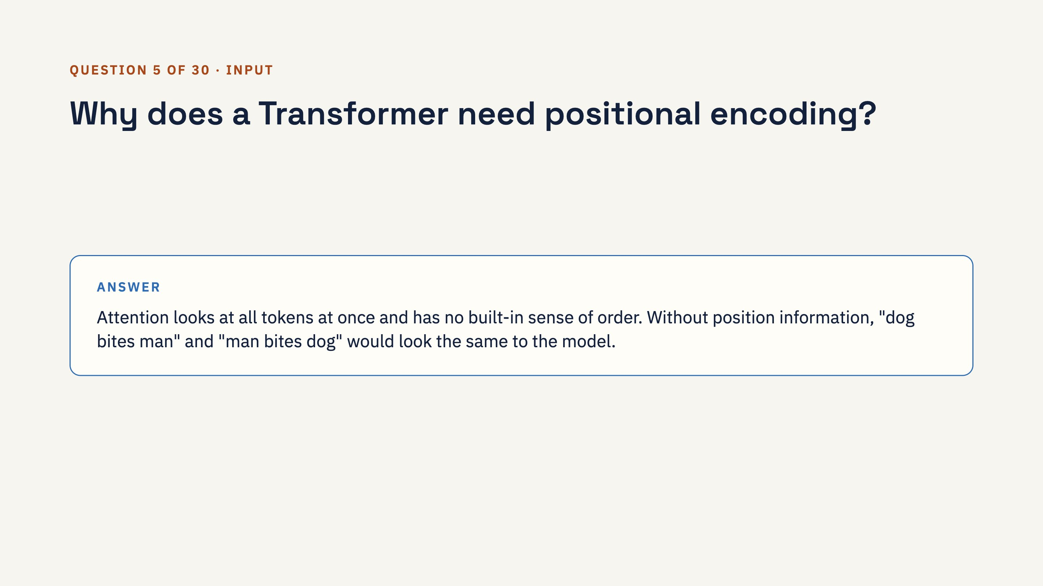
Notes:
Ask the class first, then click to reveal the answer.

Slide 37
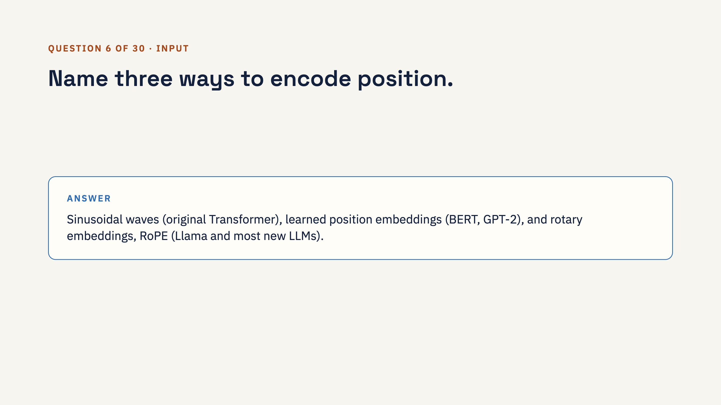
Notes:
Ask the class first, then click to reveal the answer.

Slide 38
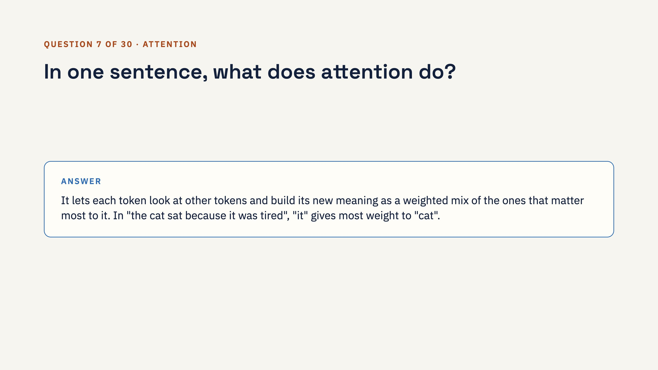
Notes:
Ask the class first, then click to reveal the answer.

Slide 39

Notes:
Ask the class first, then click to reveal the answer.

Slide 40
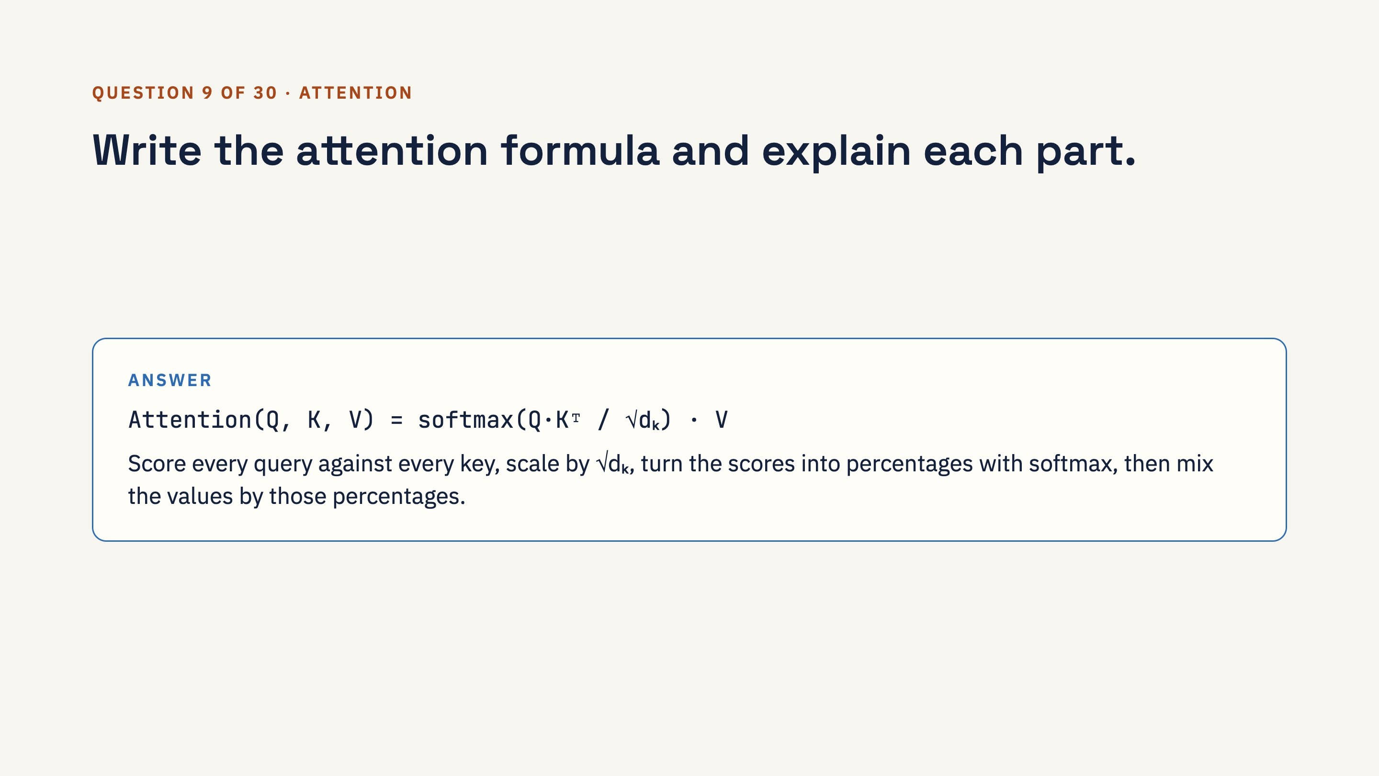
Notes:
Ask the class first, then click to reveal the answer.

Slide 41
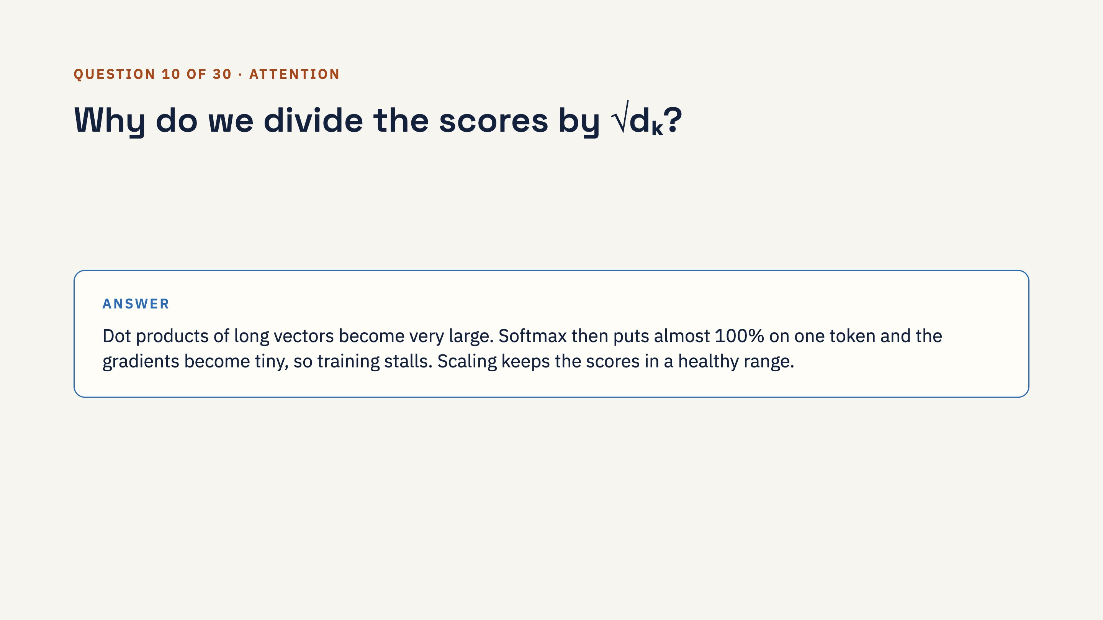
Notes:
Ask the class first, then click to reveal the answer.

Slide 42
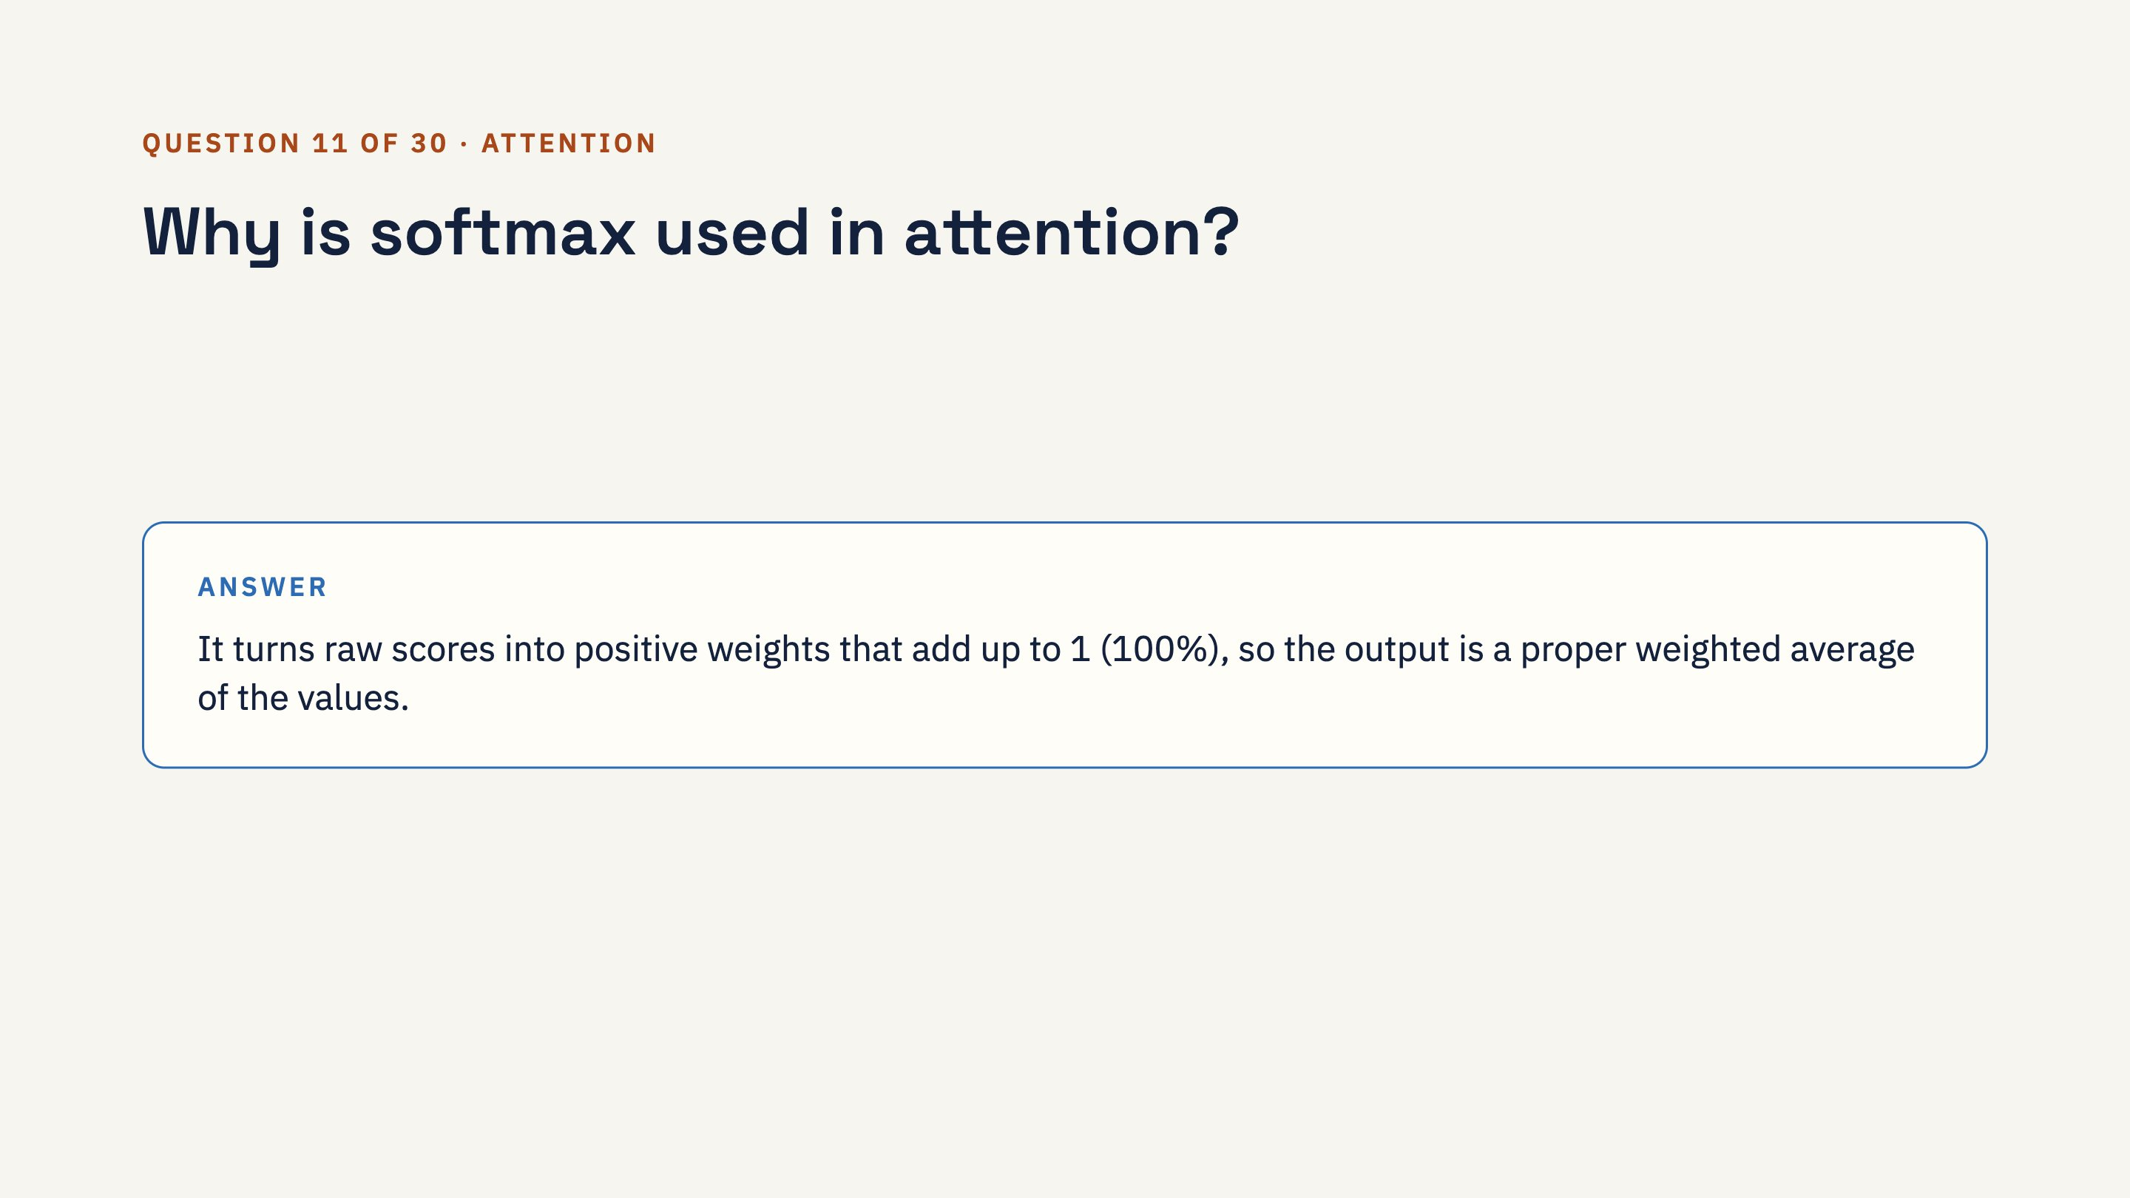
Notes:
Ask the class first, then click to reveal the answer. Follow-up: because the weights must add up to 100%, attention always goes somewhere, which explains "attention sinks".

Slide 43
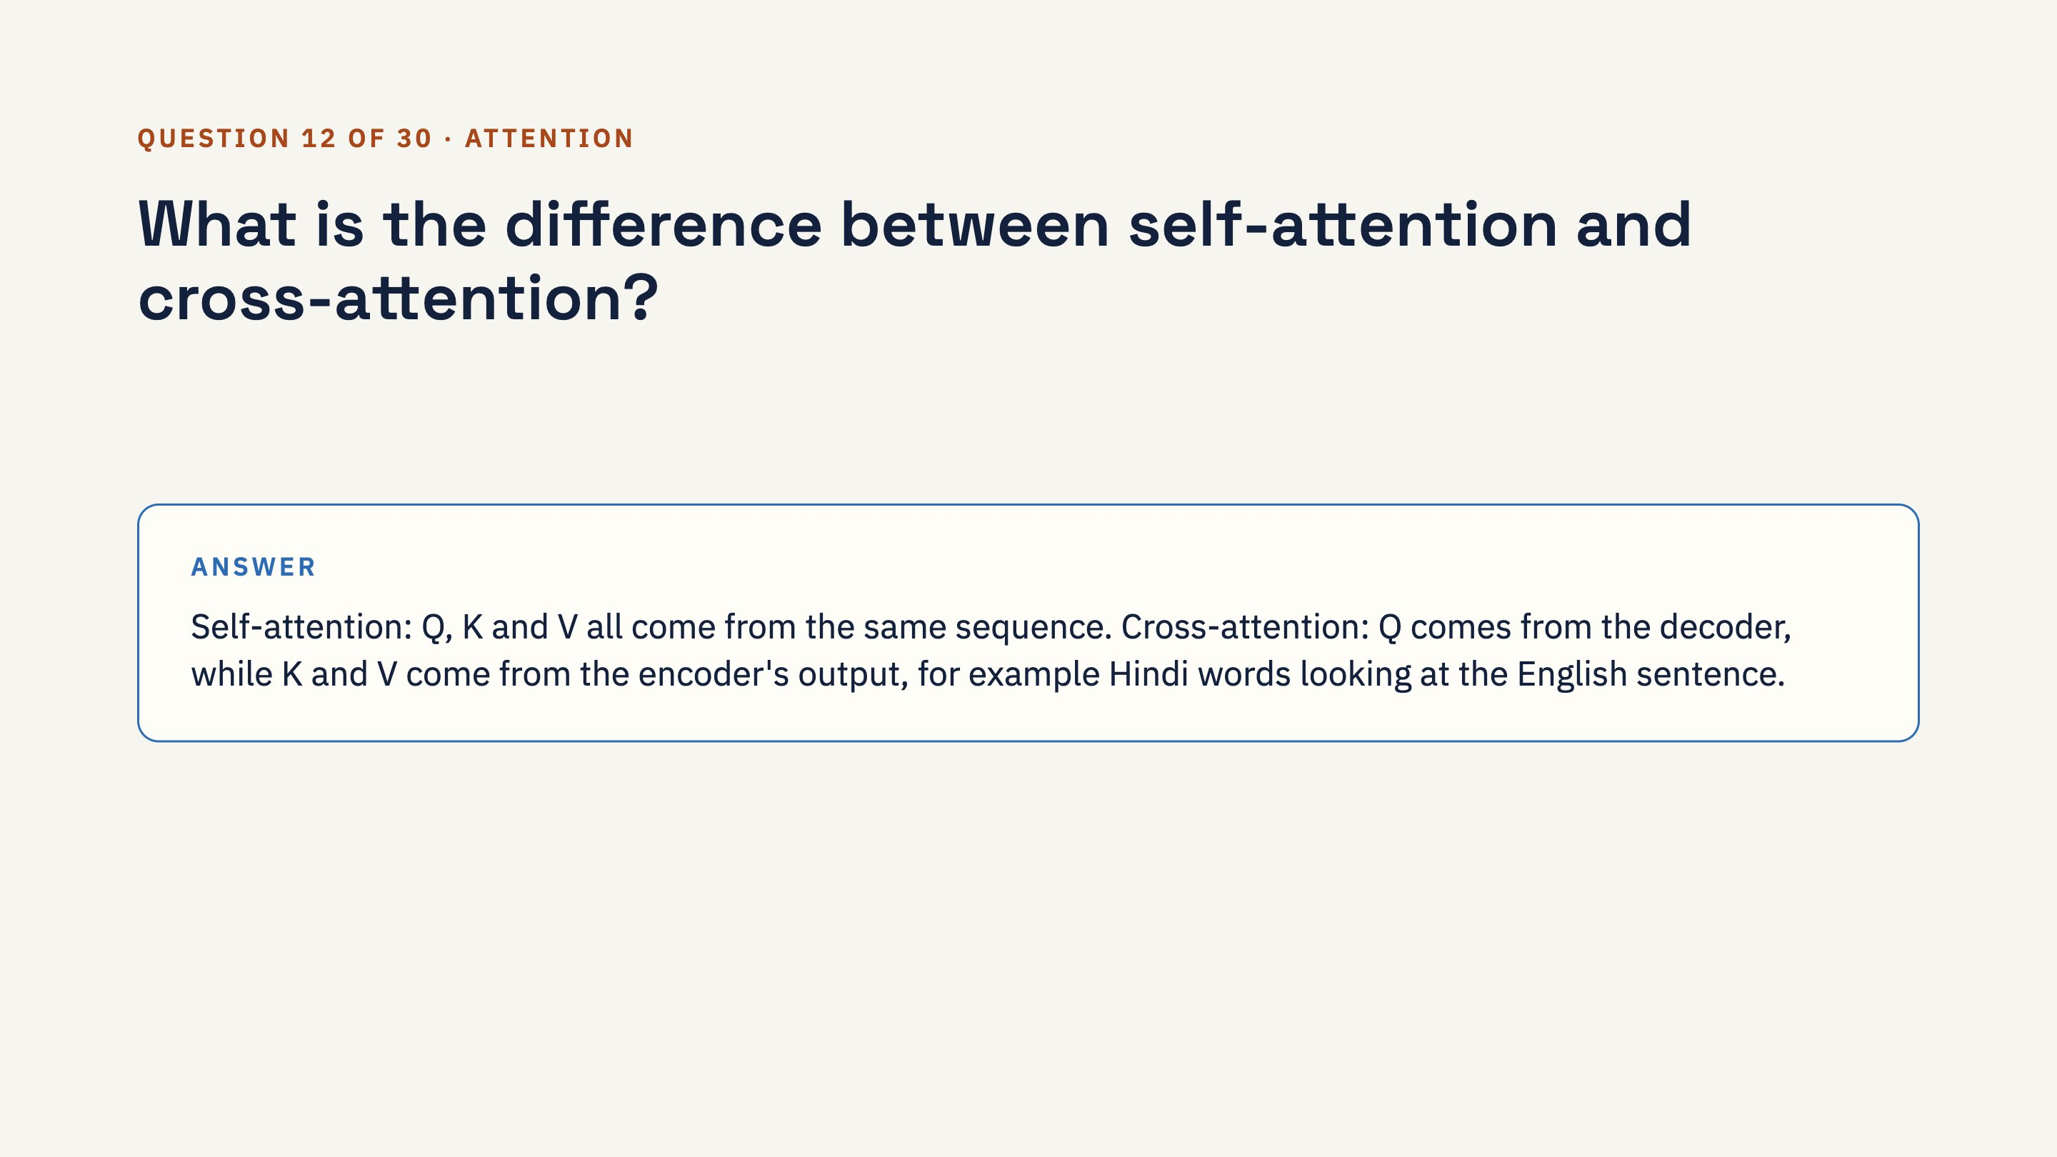
Notes:
Ask the class first, then click to reveal the answer.

Slide 44
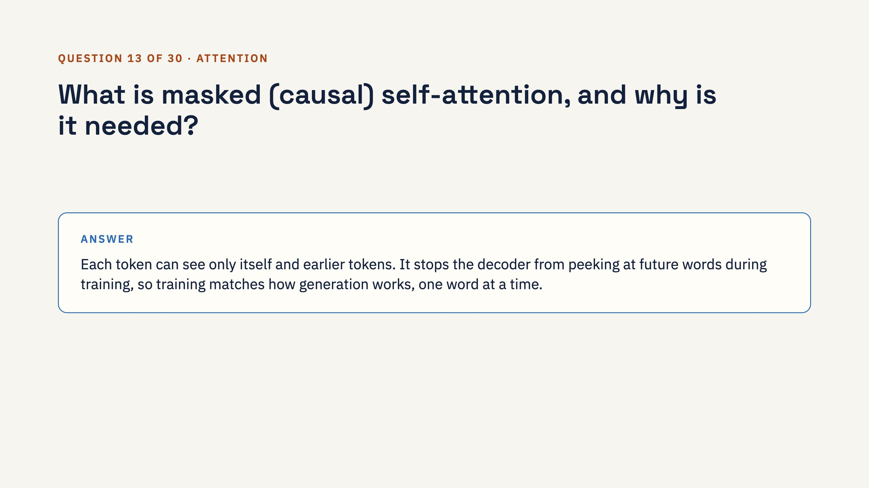
Notes:
Ask the class first, then click to reveal the answer.

Slide 45
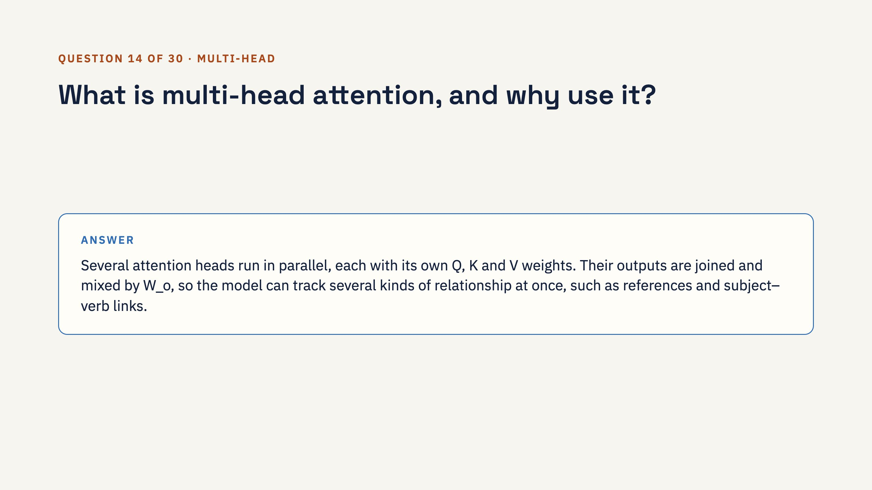
Notes:
Ask the class first, then click to reveal the answer.

Slide 46
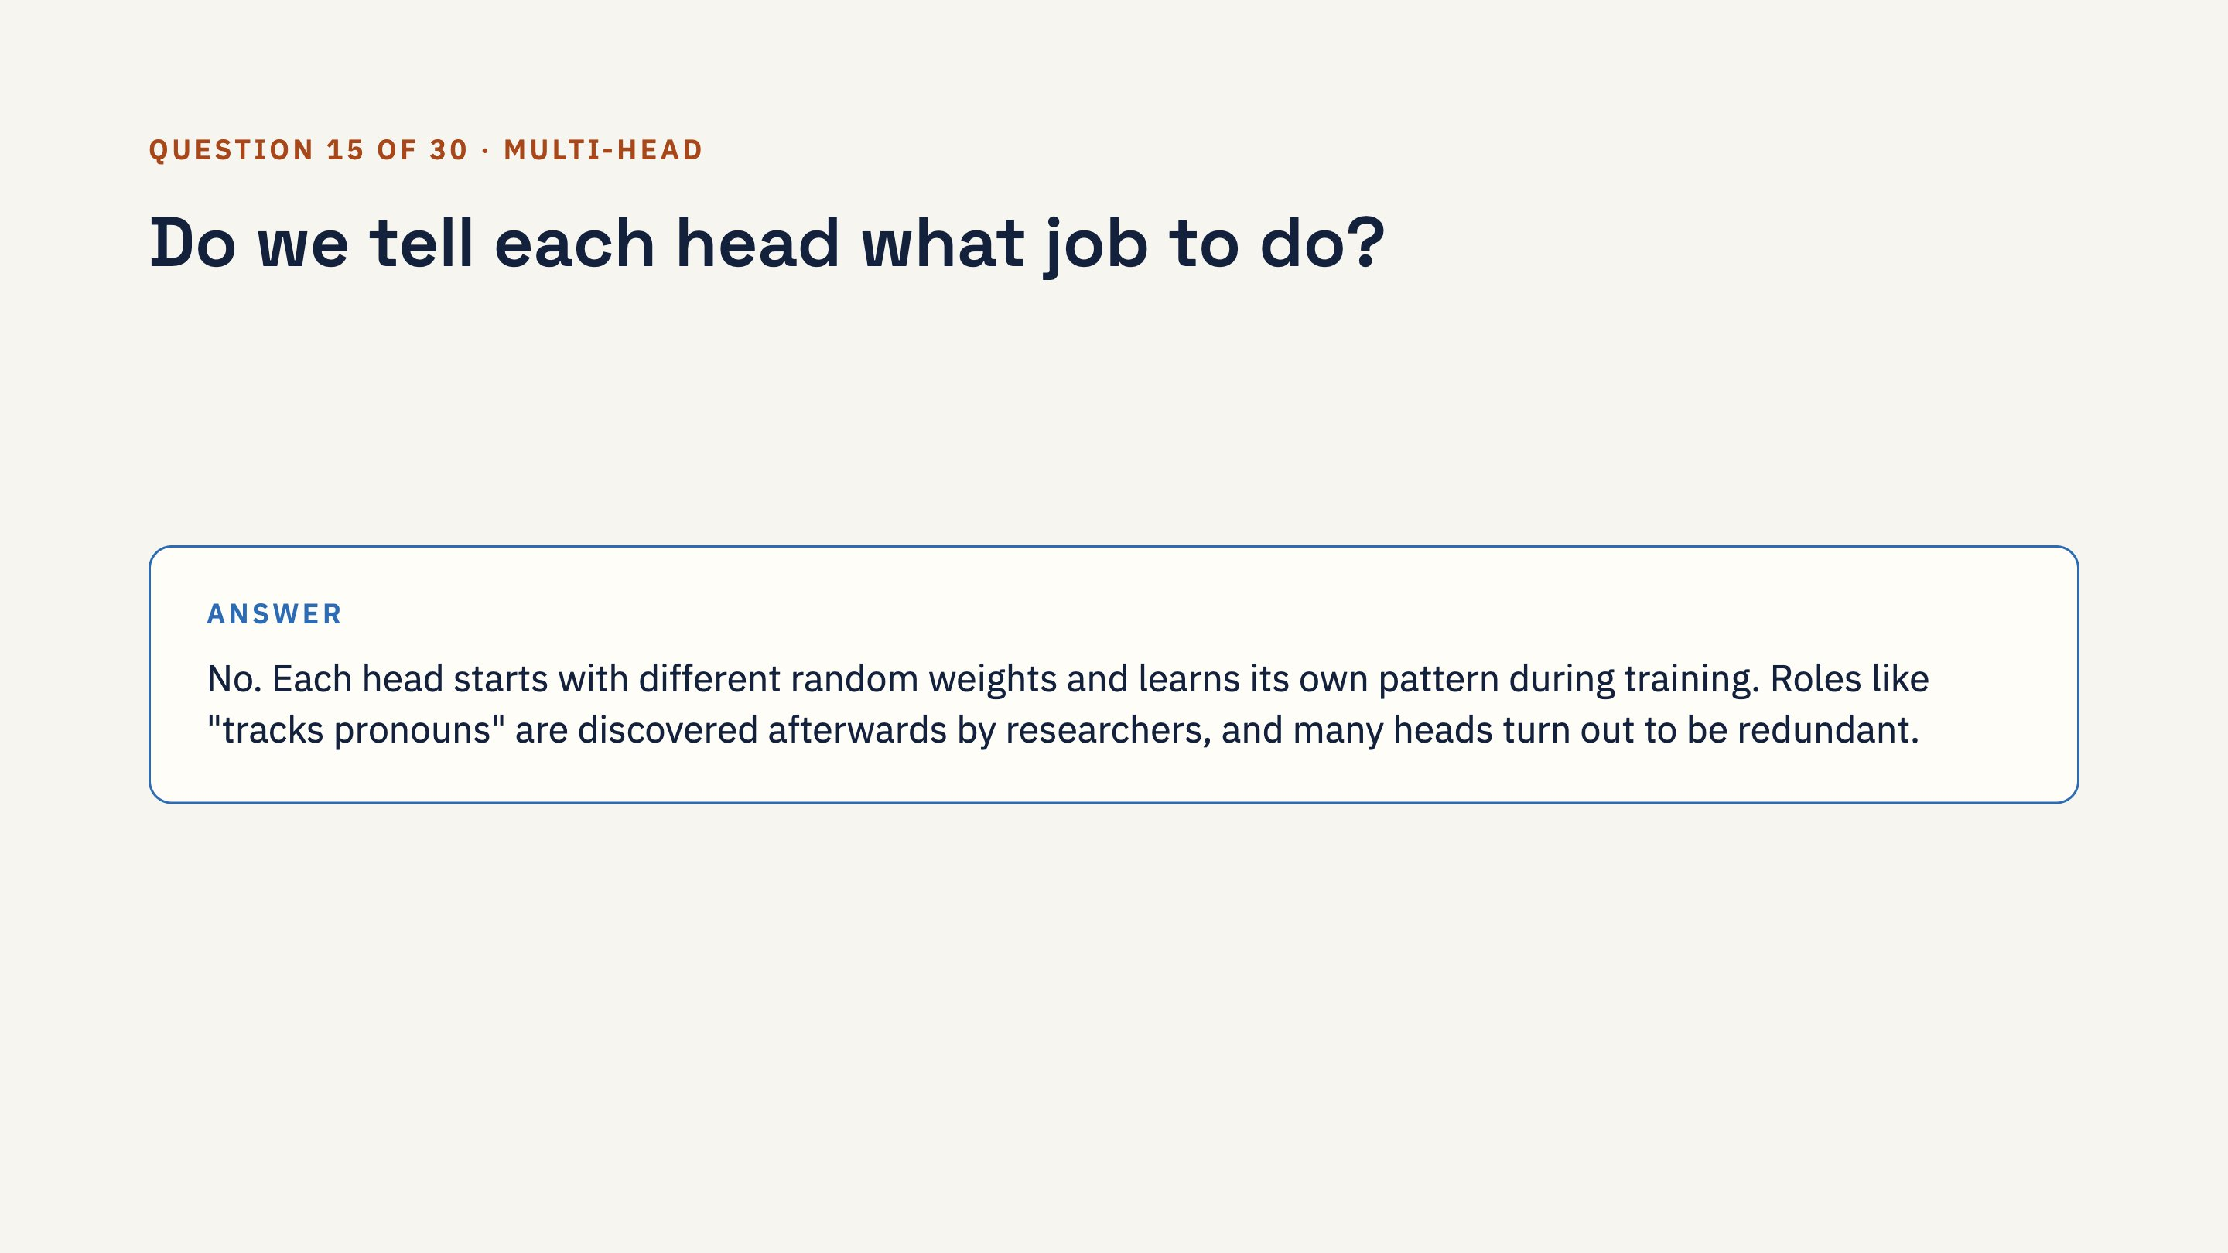
Notes:
Ask the class first, then click to reveal the answer.

Slide 47
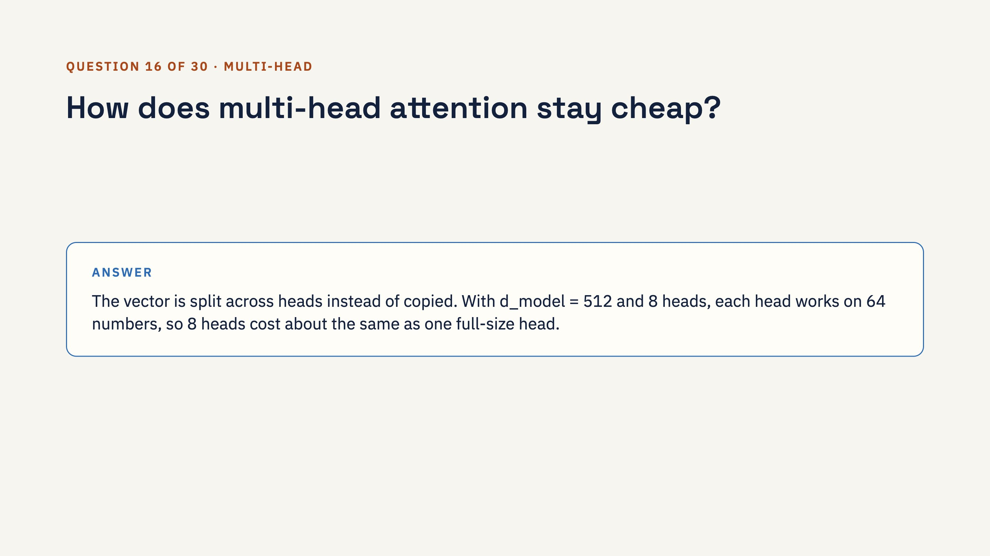
Notes:
Ask the class first, then click to reveal the answer.

Slide 48
Notes:
Ask the class first, then click to reveal the answer.

Slide 49
Notes:
Ask the class first, then click to reveal the answer.

Slide 50
Notes:
Ask the class first, then click to reveal the answer.

Slide 51
Notes:
Ask the class first, then click to reveal the answer.

Slide 52
Notes:
Ask the class first, then click to reveal the answer.

Slide 53
Notes:
Ask the class first, then click to reveal the answer.

Slide 54
Notes:
Ask the class first, then click to reveal the answer.

Slide 55
Notes:
Ask the class first, then click to reveal the answer.

Slide 56
Notes:
Ask the class first, then click to reveal the answer.

Slide 57
Notes:
Ask the class first, then click to reveal the answer. Follow-up: tricks like FlashAttention make this much faster in practice, but the exact computation still scales with length squared.

Slide 58
Notes:
Ask the class first, then click to reveal the answer.

Slide 59
Notes:
Ask the class first, then click to reveal the answer. Why they look alike: both turn things into vectors and find what is most similar. Attention is soft, learned and token-level; RAG retrieval picks the top few chunks with a separate embedding model and vector database.

Slide 60
Notes:
Ask the class first, then click to reveal the answer.

Slide 61
Notes:
Ask the class first, then click to reveal the answer. Point back to the tiny agent notebook: the brain is a TinyGPT, the hands are plain Python functions.

Slide 62
Notes:
Close by pointing to the two notebooks for practice and the 30 questions for revision. Suggested homework: run the tiny GPT notebook and complete one of its "try it yourself" exercises.

